Slide 1
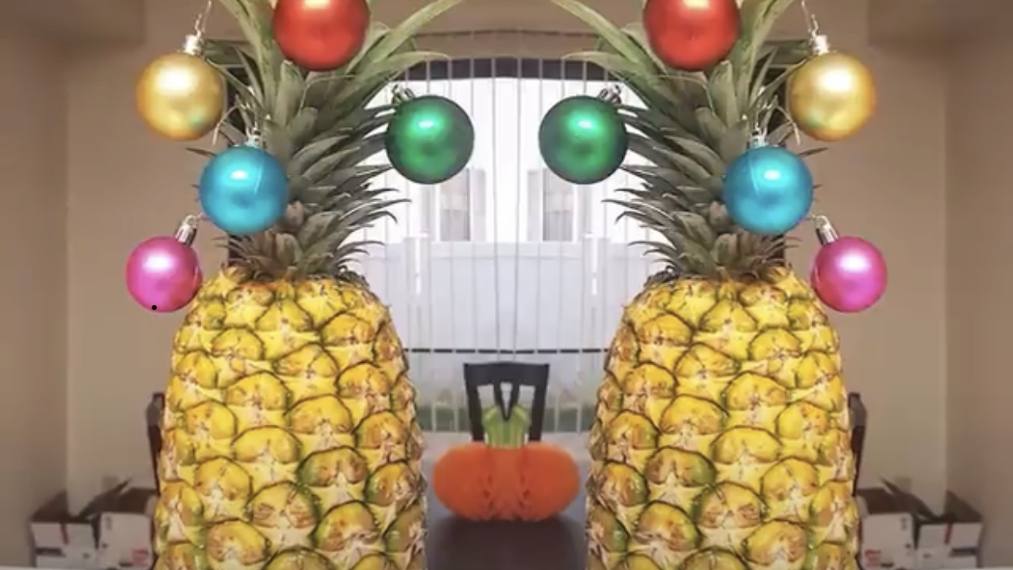
HOLIDAY
GUIDE

Slide 2
With only a short time left of the year, make the most of the fun holidays coming up to “Make Friends First” with your guests.
Begin their stay with a sweet welcome and help warm their hearts to your team and your property reviews.
Lead from the Heart and be intentional about creating an extraordinary holiday experience.
Friends
Make
First
Notes:
Add make friends first slide

Slide 3
NOVEMBER AND DECEMBER HOLIDAYS
All Saint's Day
Dia de los Muertos (Day of the Dead)
All Soul's Day - usually on the 2nd
Daylight Savings time ends gain 1 hour of sleep
U.S. General Election Day - please exercise your right to vote
Veteran's Day
Caregiver Appreciation Day
Sadie Hawkins Day
Universal Children's Day
Great American Smokeout - third Thursday
Thanksgiving Day - fourth Thursday
Black Friday - day after Thanksgiving
Daily November holidays and special days
St. Nicholas Day
Advent begins
Pearl Harbor Day
Poinsettia Day
Chanukah lasts 8 days
Winter Solstice (shortest day of the year)
Festivus - for the rest of us!
Christmas
Boxing Day
Kwanzaa
National Fruitcake Day
New Year's Eve
Daily December holidays and special days

Slide 4
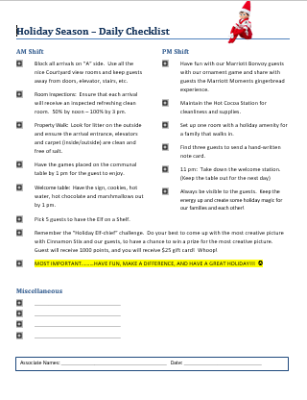
HOLIDAY CHECKLIST
Double Click 👉🏼
Create a holiday checklist outlining key drivers and special activities that are different during the holidays. It might be an occupancy swing or holiday enhancements.

Slide 5
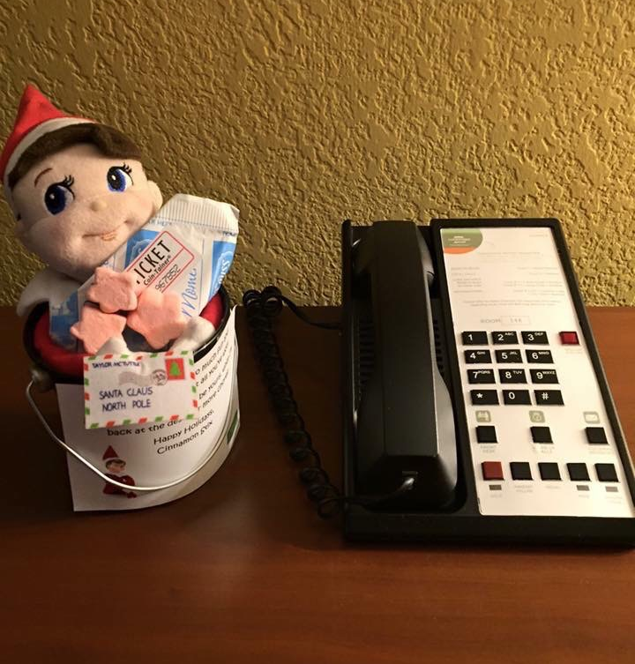
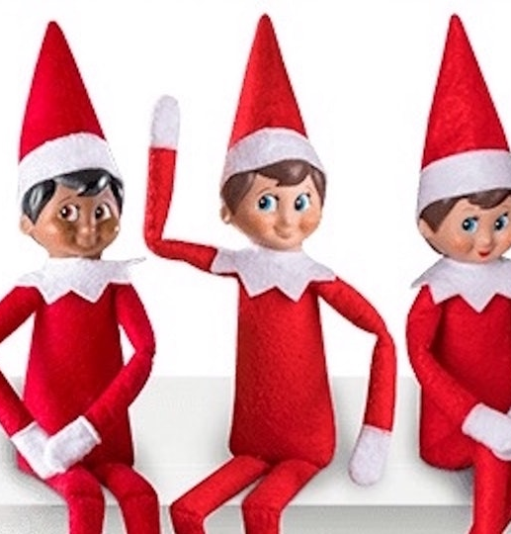
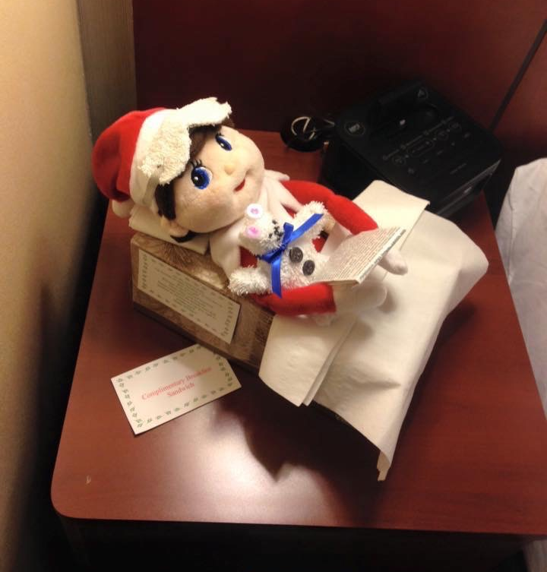
ELF ON A SHELF
Have fun selecting a few guests each day to receive a surprise or have an elf scavenger hunt in the lobby!

Slide 6
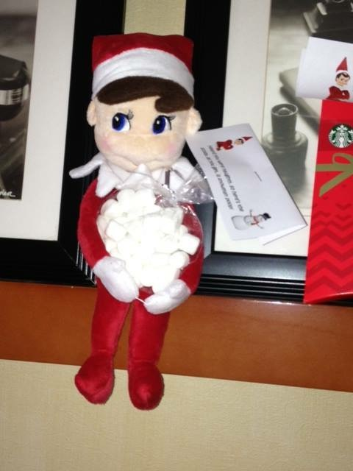
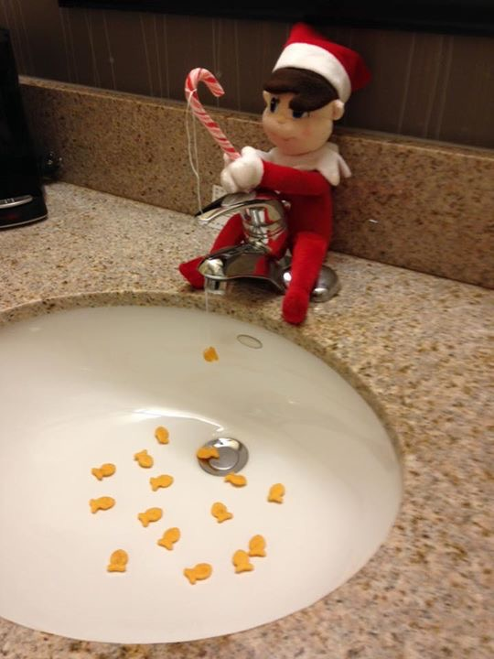
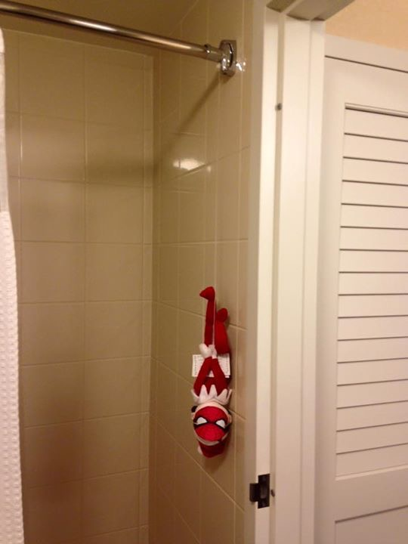
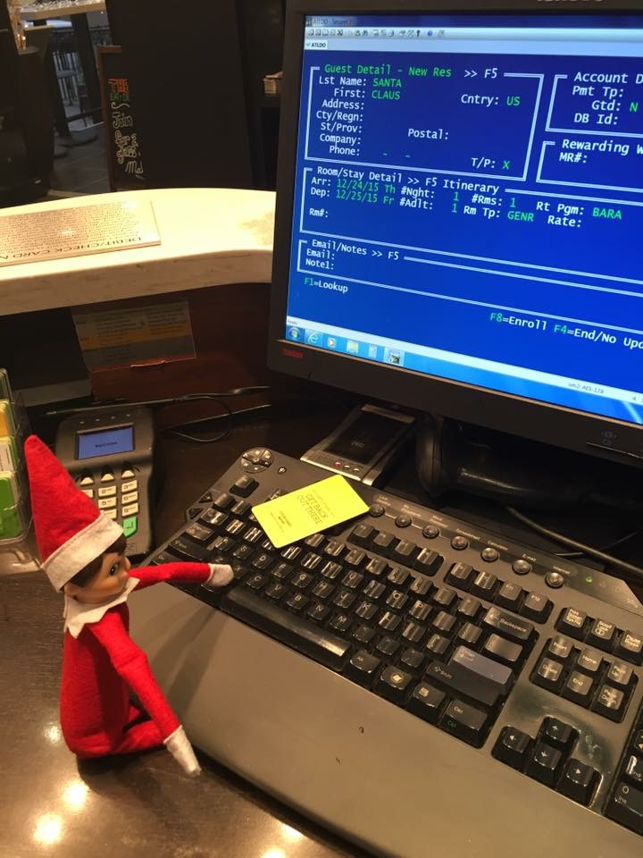
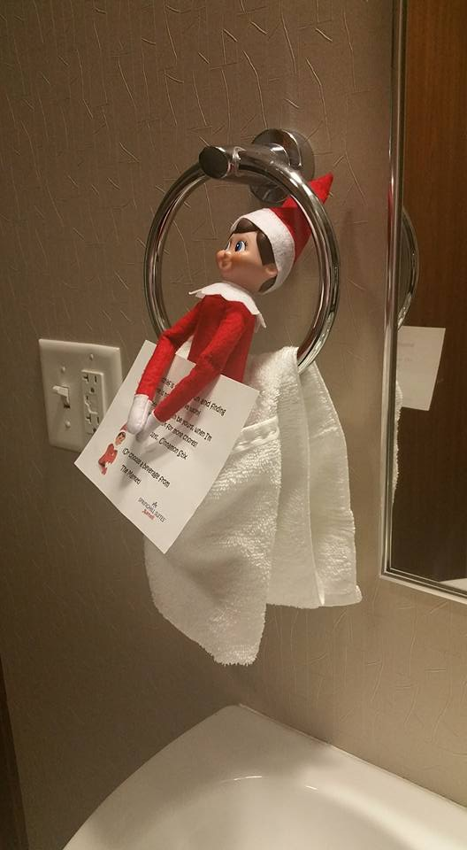
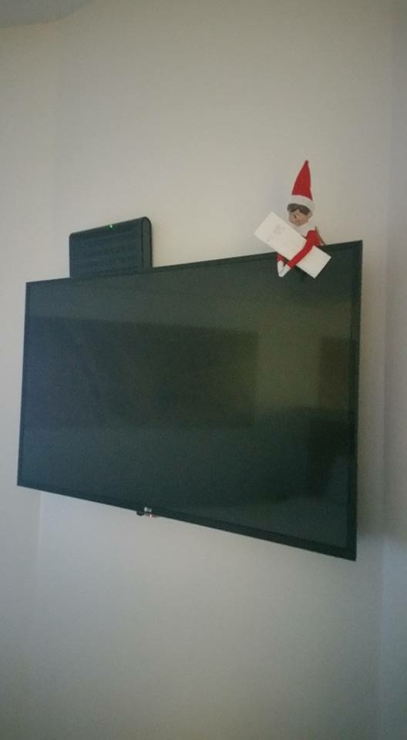
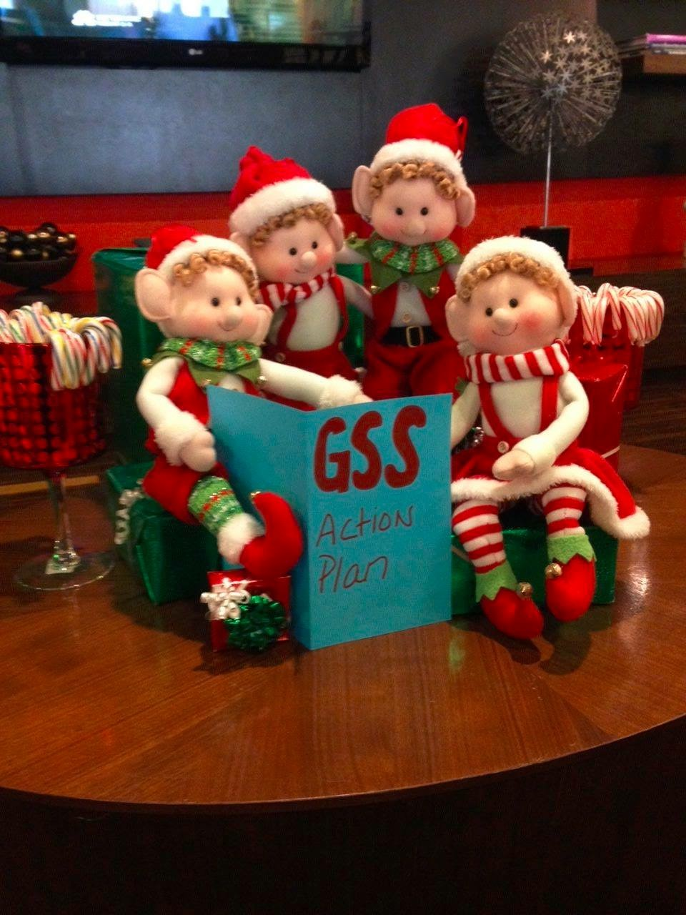
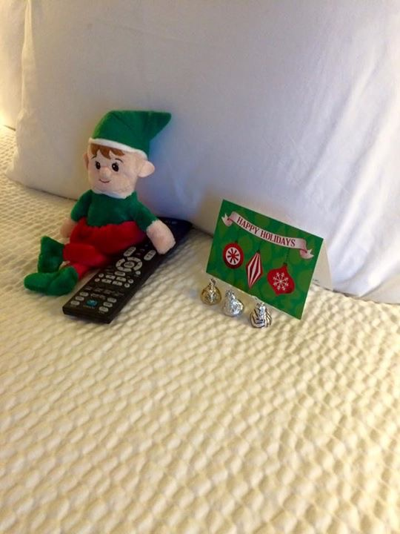

Slide 7
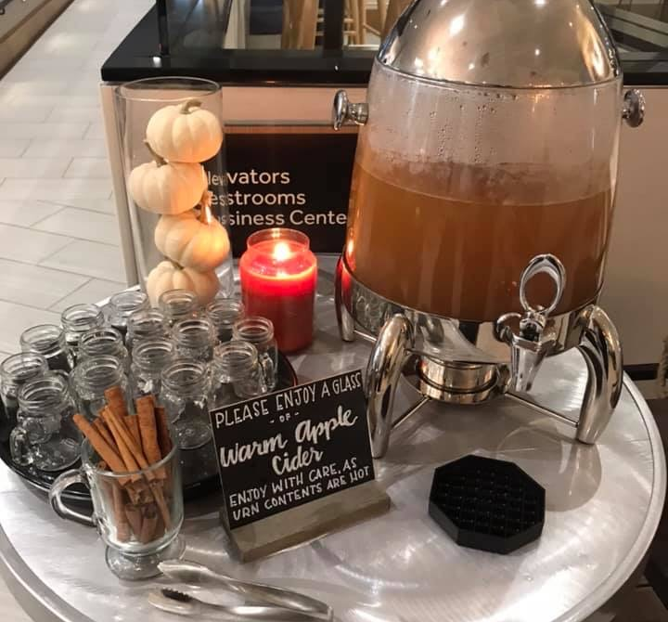
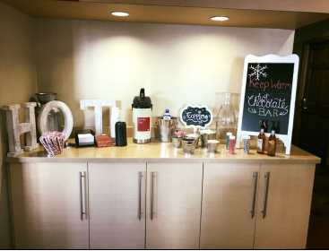
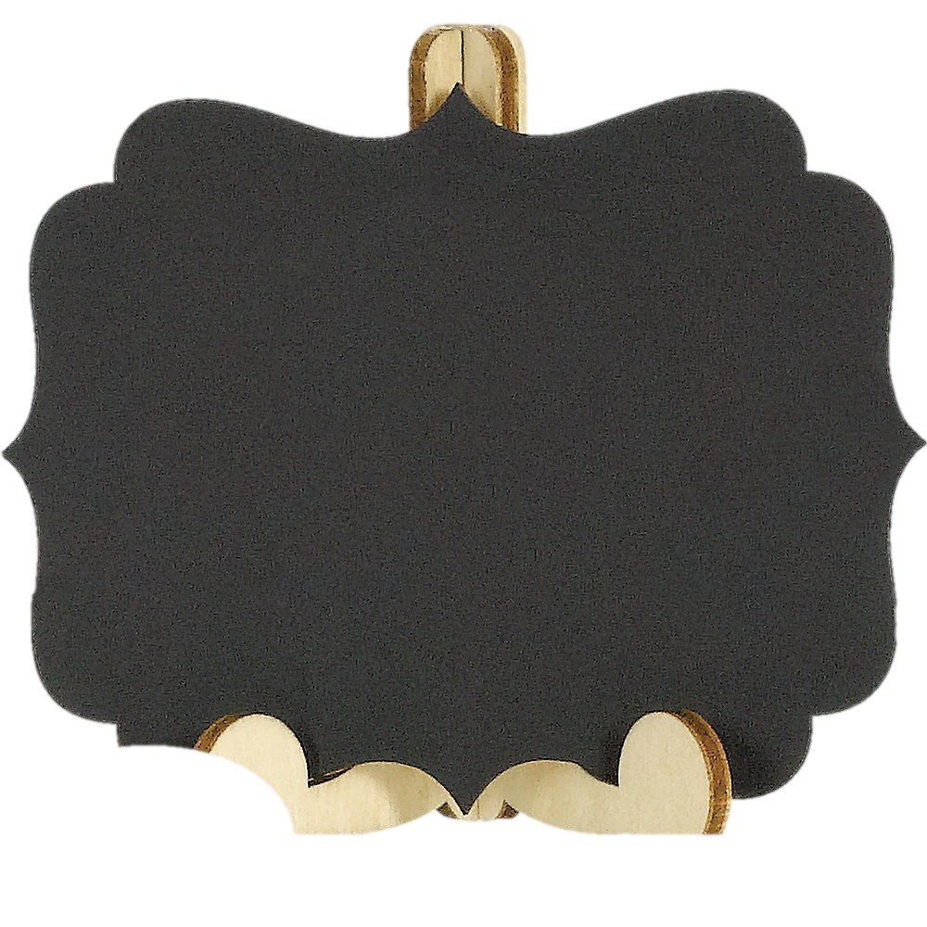
HOT CIDER
AND COCOA
WELCOME STATION
Notes:
TPS Dundee and Deptford Courtyard

Slide 8
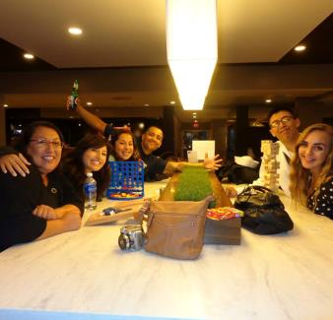
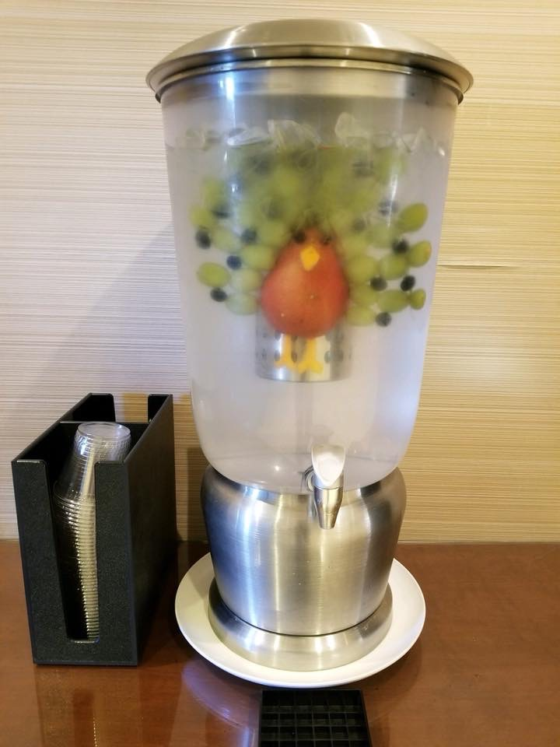
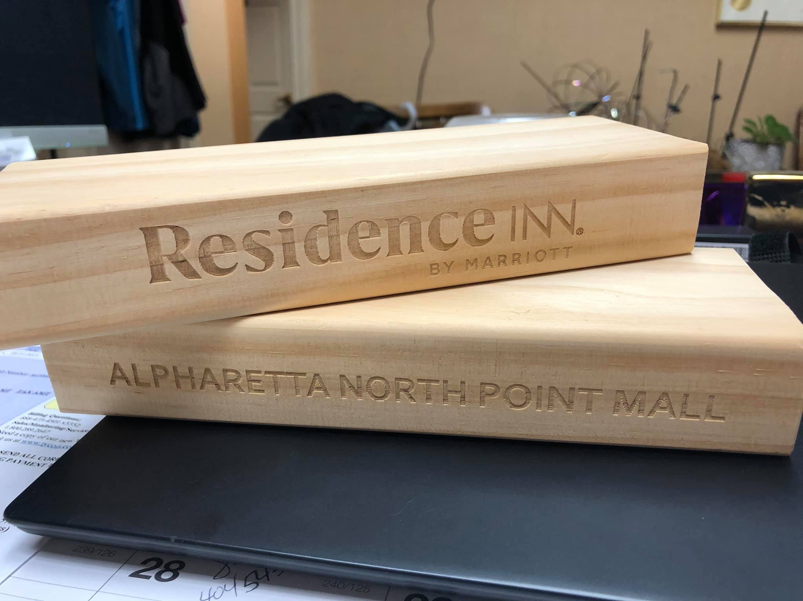
MAKE ROOM FOR A LITTLE FUN WITH GAMES IN THE LOBBY
Nehali Patel
Victorytailgate.com
Fun lobby water
GET A CUSTOM JENGA ->

Slide 9
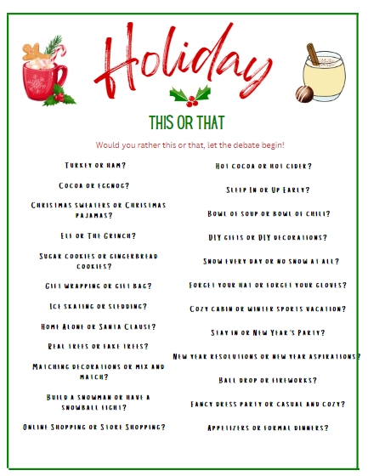
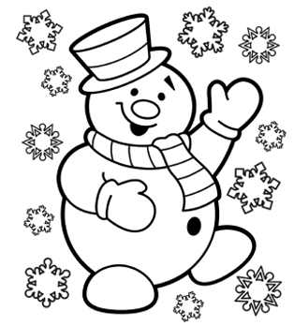
CREATE COLORING BOOKS FOR THE KIDS
HOST A COLORING CONTEST
Double Click 👉🏼
Double Click 👉🏼

Slide 10
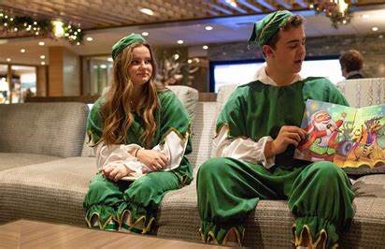
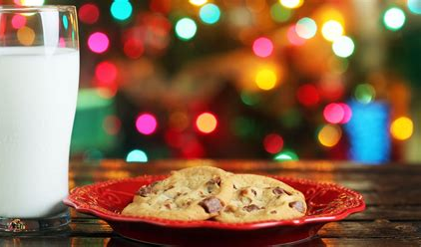
ROOM PACKAGES OR EVENTS TO CREATE MEMORIES!
PHOTO OP STATIONSTHAT ARE INSTAGRAMABLE!

Slide 11
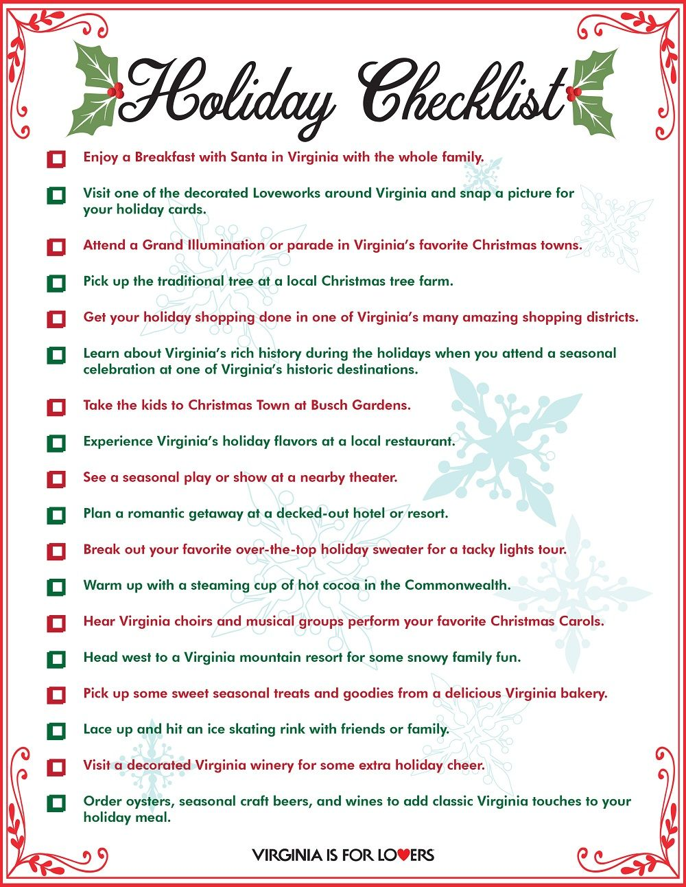
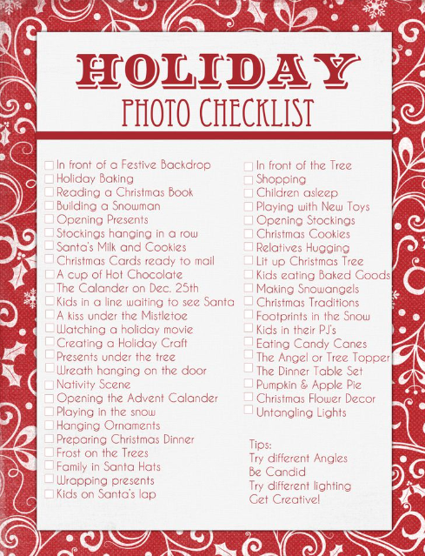
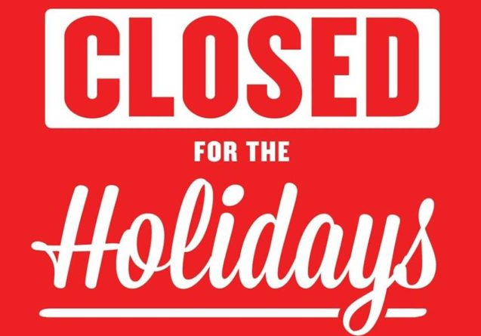
CREATE A
HOLIDAY LIST
OF FUN THINGS
TO DO IN YOUR AREA
CREATE A
HOLIDAY LIST OF RESTAURANTS THAT ARE OPEN FOR THE HOLIDAY

Slide 12
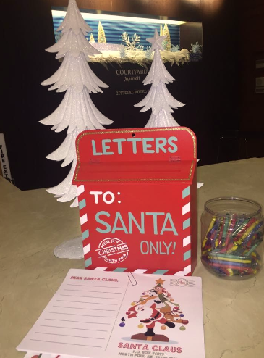
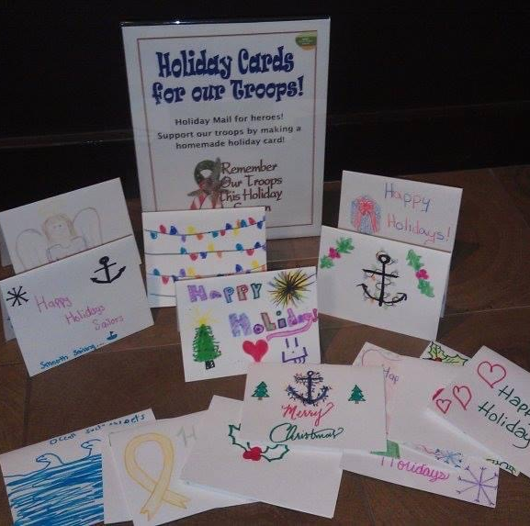
LETTERS TO SANTA
Have a station where kids can write a letter to Santa and send them a note back.
Or have a station where guests can make a card for the troops or a local senior home.
Notes:
The Emmeryville CY is making room for a little fun with letters to santa!

Slide 13
Bartender, I’ll have another! KEEP THE BAR OPEN!
Often with low occupancy, we close outlets, and this always ends with bad GSS due to disappointed expectations.
Notes:
PUT a BEER in their HANDS, or a captain and diet!

Slide 14
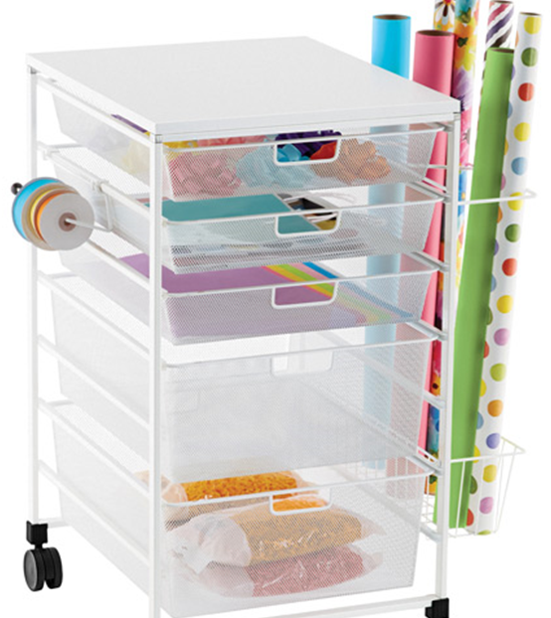
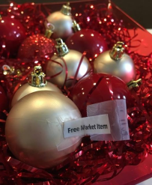
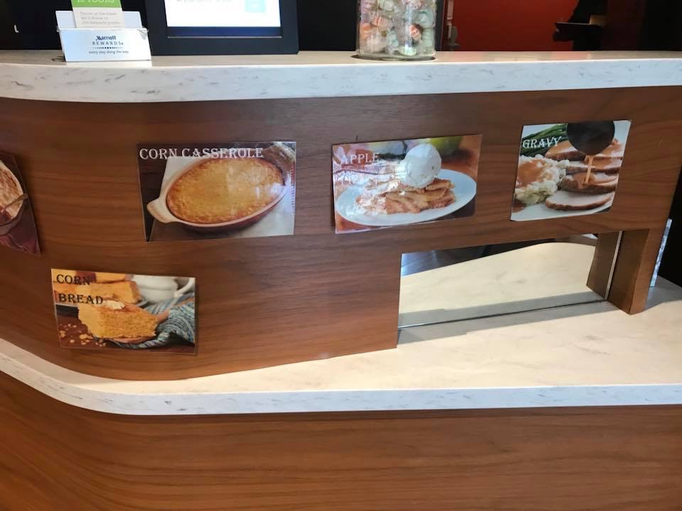
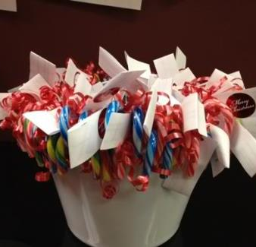
GUEST WRAPPING STATION
FUN ELITE RECOGNITION
Have guests randomly pick from items where they will have various prizes.
Notes:
Here’s another great Elite Recognition idea from RI San Antonio airport Mystery Ornaments.
And the TPS Brand has a partnership with the container store and has encouraged their hotels to offer a gift wrap station. This is a great idea for all of our hotels!

Slide 15
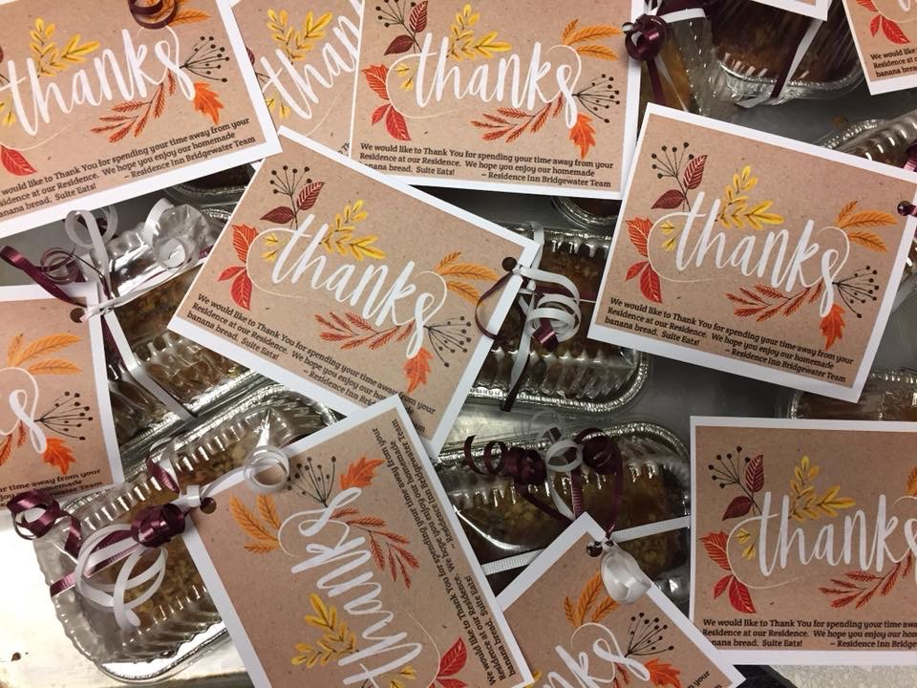
PILLOW TALK HOLIDAY CARD/LETTER AND TREAT
Notes:
HAND write a Holiday letter
Welcome guests, let them know what you have available, and how you want to be a part of their celebration!

Slide 16
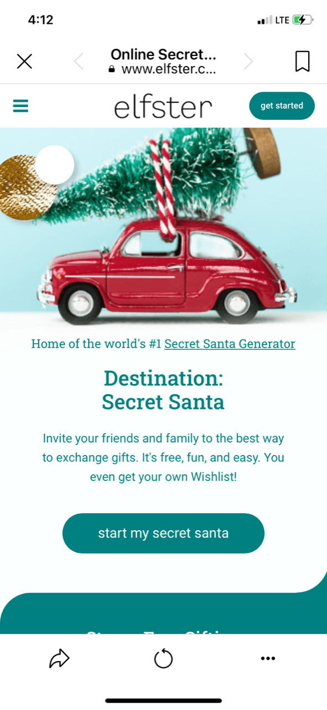
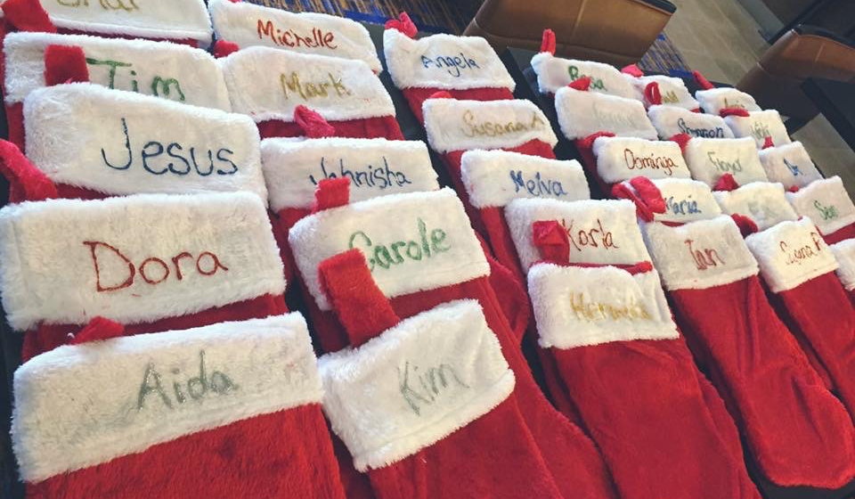
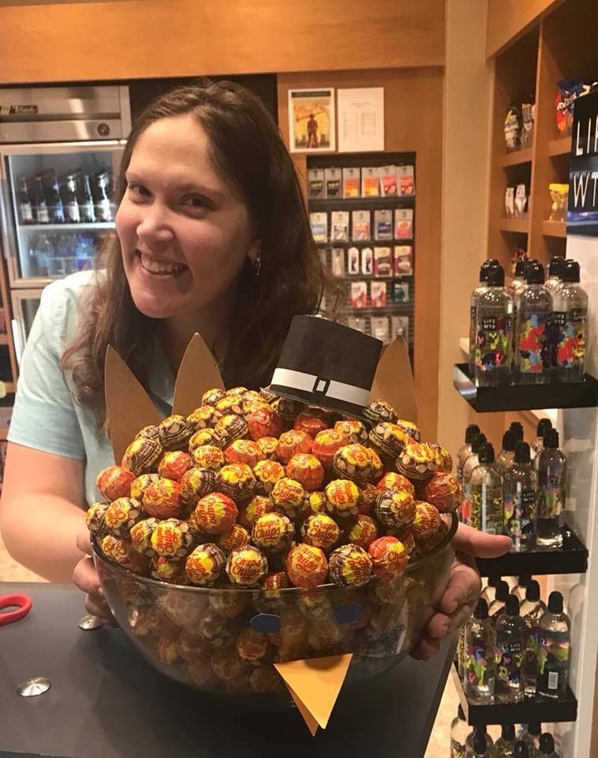
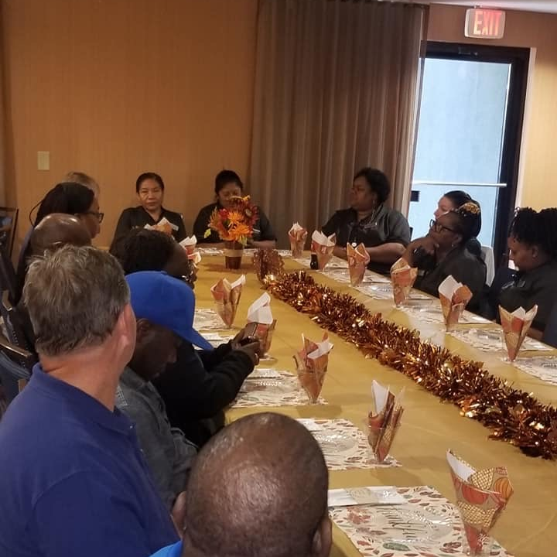
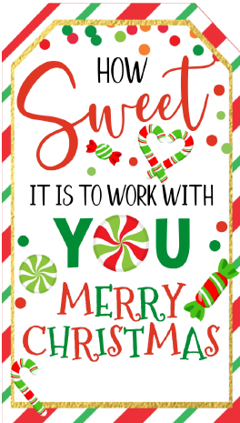
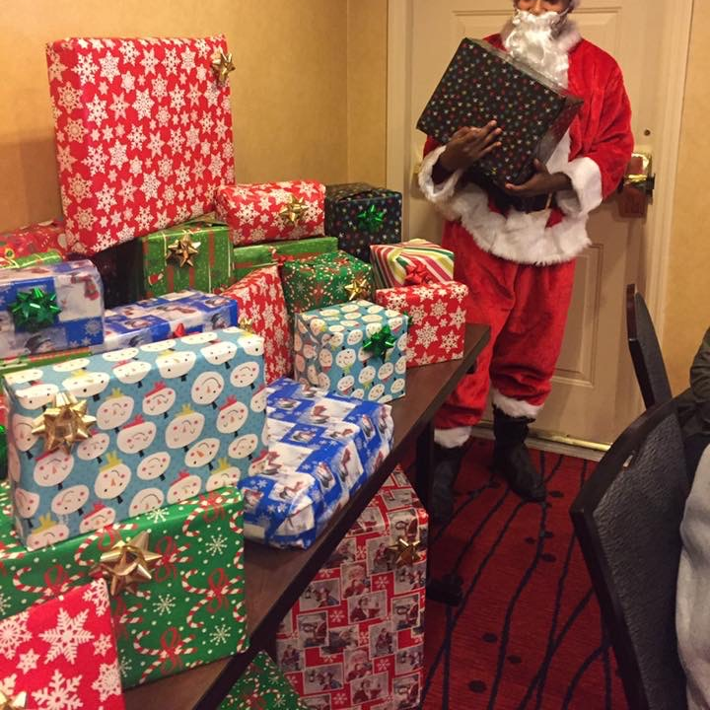
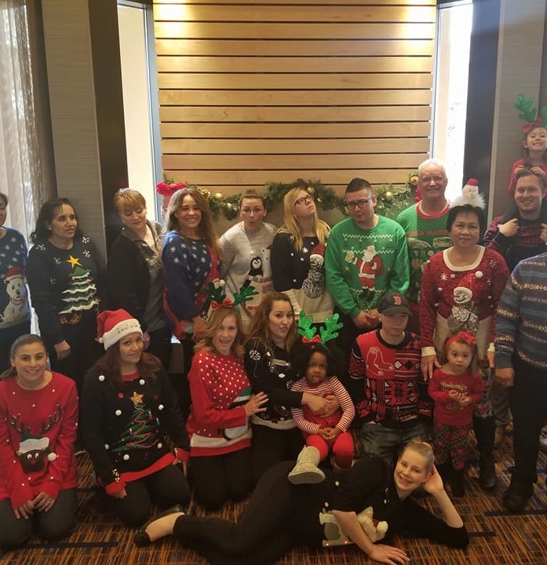
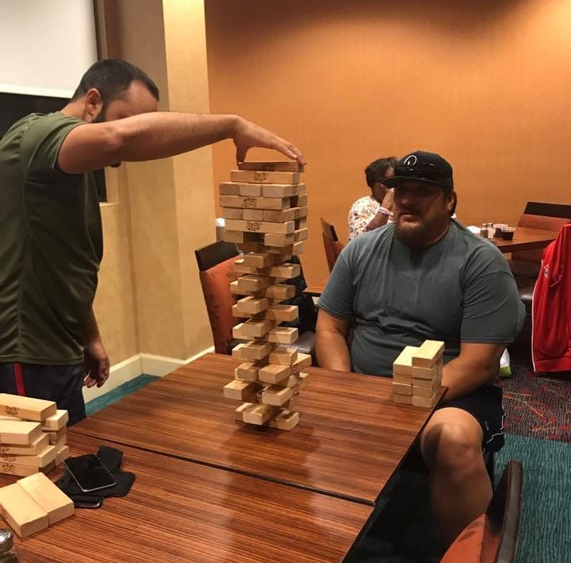
CELEBRATE WITH YOUR TEAM!

Slide 17
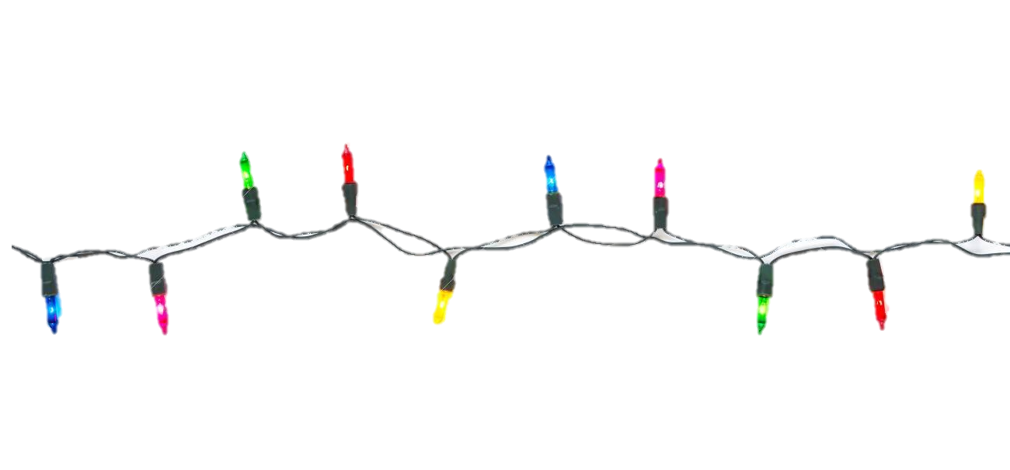
SAY YES TO PUTTING A BOOK IN EVERYONE’S STOCKINGS AND GET READY TO DRIVE SWEET RESULTS IN THE NEW YEAR! WHOOP-WHOOP! ORDER HERE AMAZON - YES IS THE ANSWER BOOK

