Slide 1
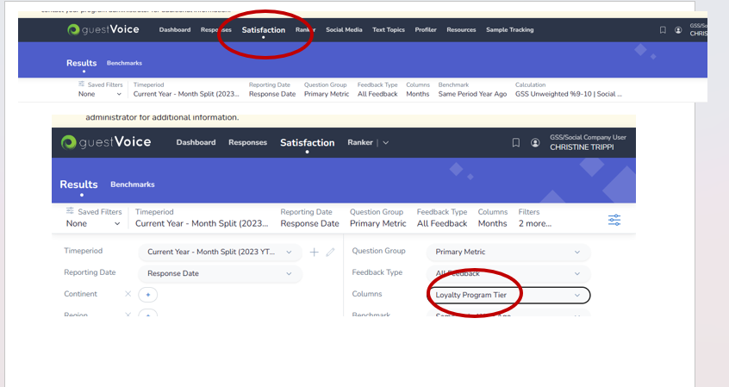
This is also where you will pull your weekend vs. Weekday report (Under Column)

Slide 2
For MARRIOTT HOTELS: This is also where you will pull your weekend vs. Weekday report (Under Column)

Slide 3
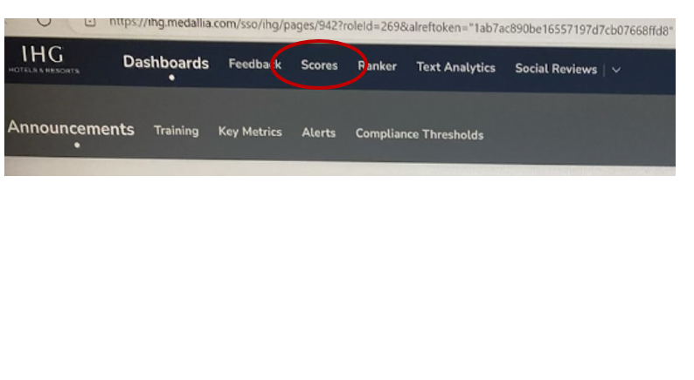
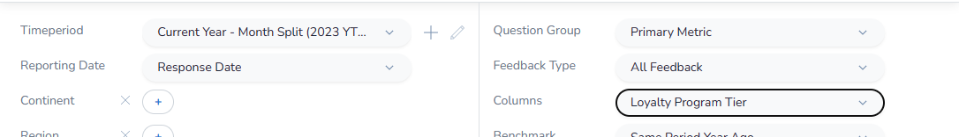
For IHG HOTELS: This is also where you will pull your weekend vs. Weekday report (Under Column)

Slide 4
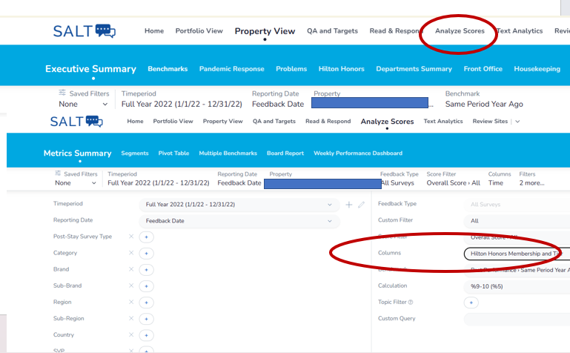
For HILTON HOTELS: This is also where you will pull your weekend vs. Weekday report (Under Column)

Slide 5
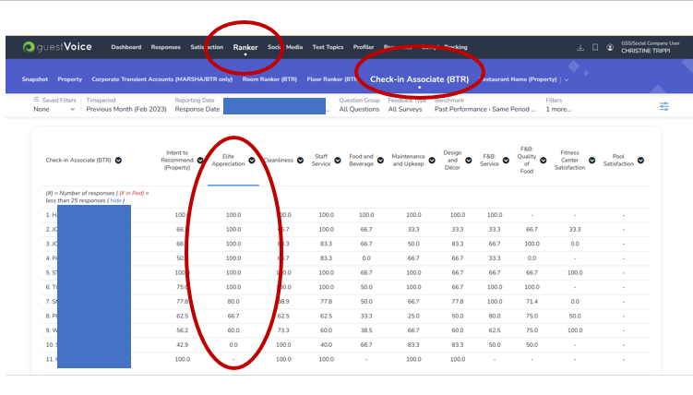
For MARRIOTT (hopefully other brands – Associate Elite Ranker

