Slide 1



The Wise Pineapple Presents
ROOM STANDARDS - LOOK BOOK
HOTEL BRAND - LOCATION

Slide 2
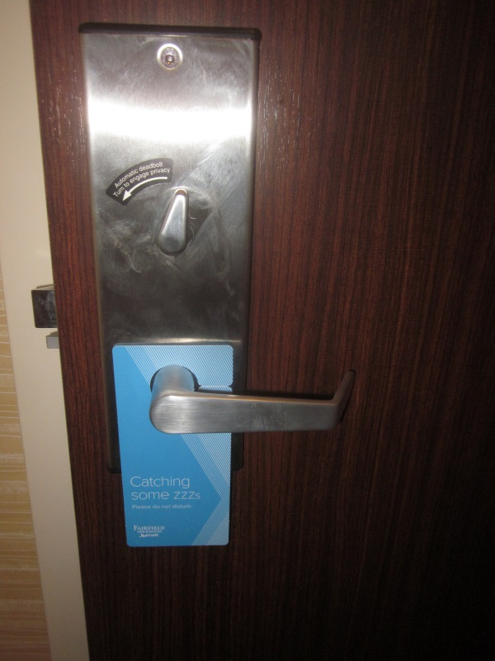
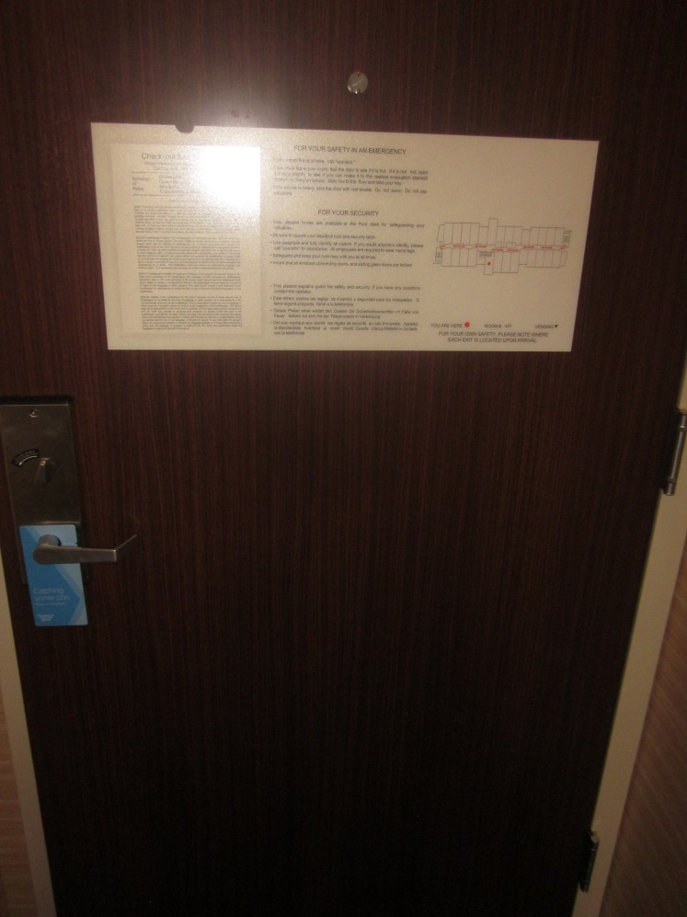

Entry
  Items Include:
  (1) Fire Evacuation Plaque
  (1) Hotel Rate/Law Card
  (1) Do Not Disturb Sign
  (1) Clean and Safe Peephole
  Smells Fresh/Neutral

Slide 3
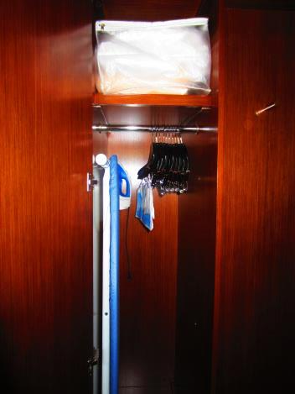
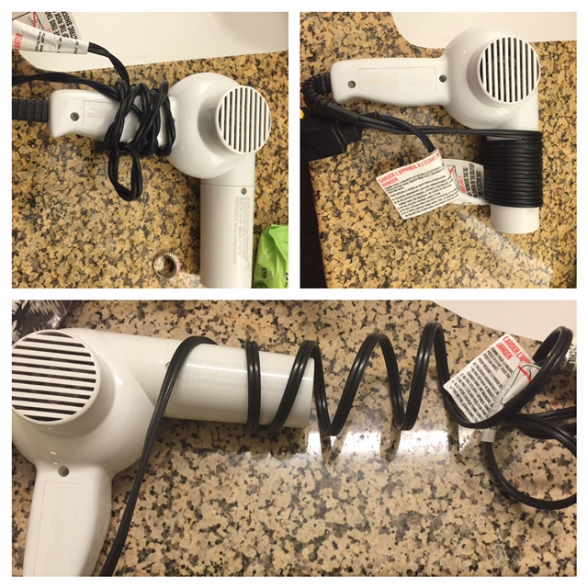
Entry - closet
Items (can) Include:
[1] Board Organizer
[1] Iron and Ironing Board
[1] Sofa Bed Linen
[1] Valet Bag and Laundry Ticket
[6] Coat Hangers
[4] Skirt Hangers
[1] Hair Dryer
Sofa Bed Items Include:
[1] Sofa Bed Linens Sticker
[1] Zippered Vinyl Bag
[1] Fitted Sheet
[1] Flat Sheet
[1] Vesta Blanket
[1] Foam Pillow

Slide 4
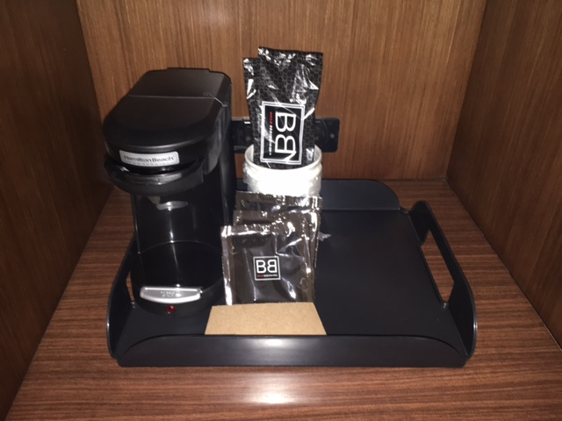
Coffee Set-up
Coffee Items Include:
[1] Coffee Maker
[1] Tray
[1] Ice Bucket w/ Matching Lid
[1] Ice Bag
[1] Reg. Coffee Packets
[1] Decaf Coffee Packets
[1] Condiment Packs
[2] Coffee Cups
[4] Drinking Glasses

Slide 5
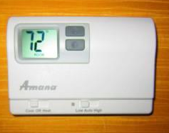
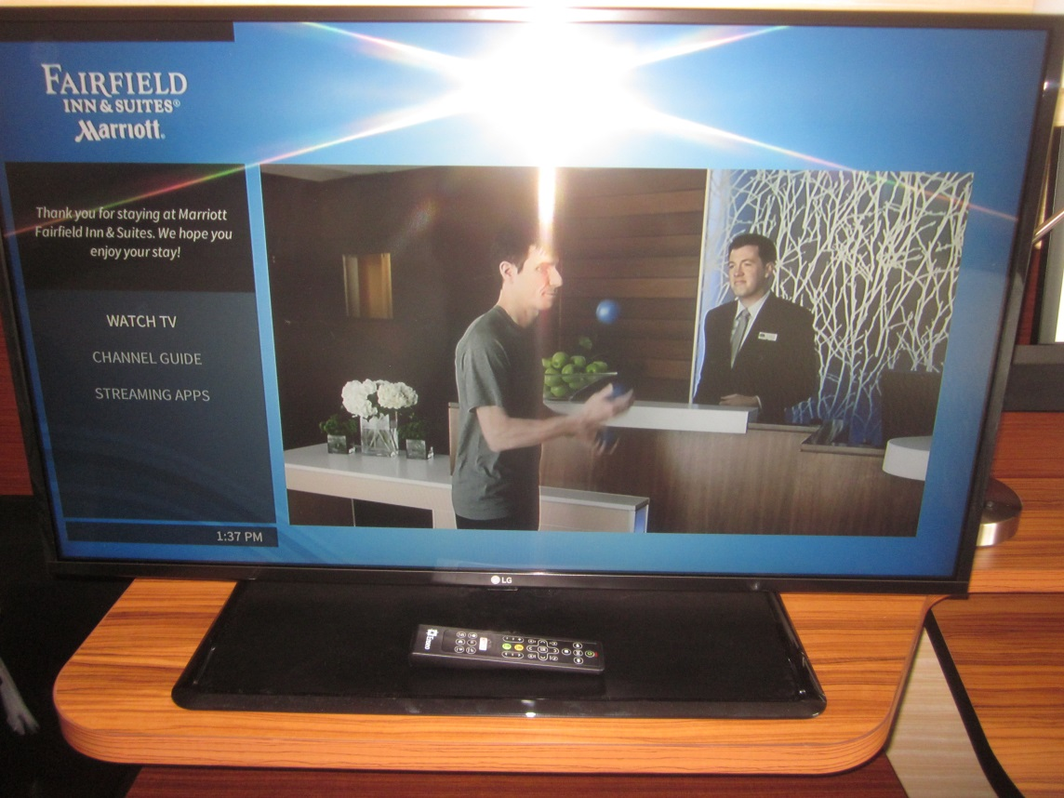
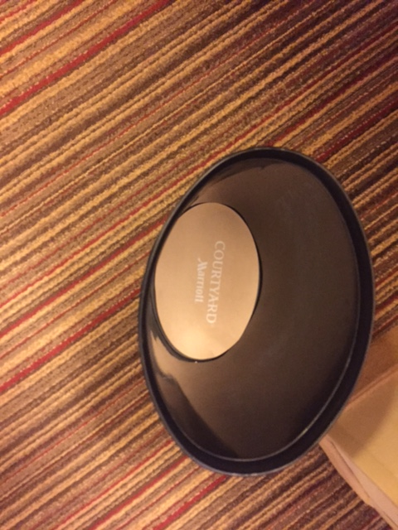
BEDROOM
Details:
72° Cool Auto – Summer/Spring
70° Heat Auto – Fall/Winter
Items Include:
[1] Television
[1] Remote Control (power button facing right)
Items Include:
[1] Welcome Light
Items Include:
[2] Waste Baskets with Paper Liner

Slide 6
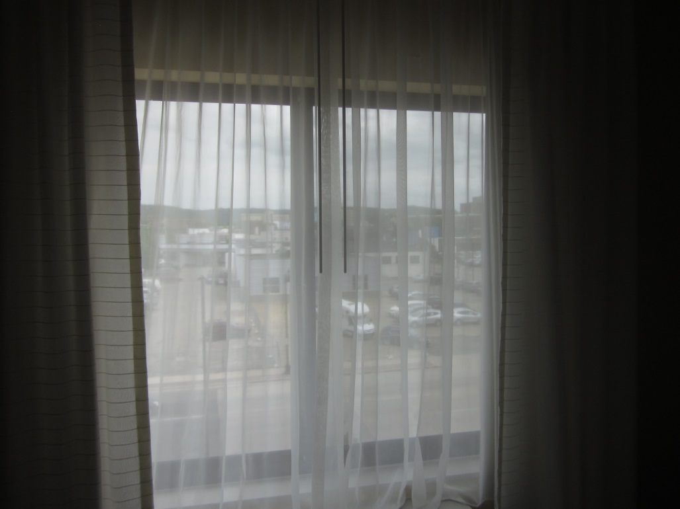
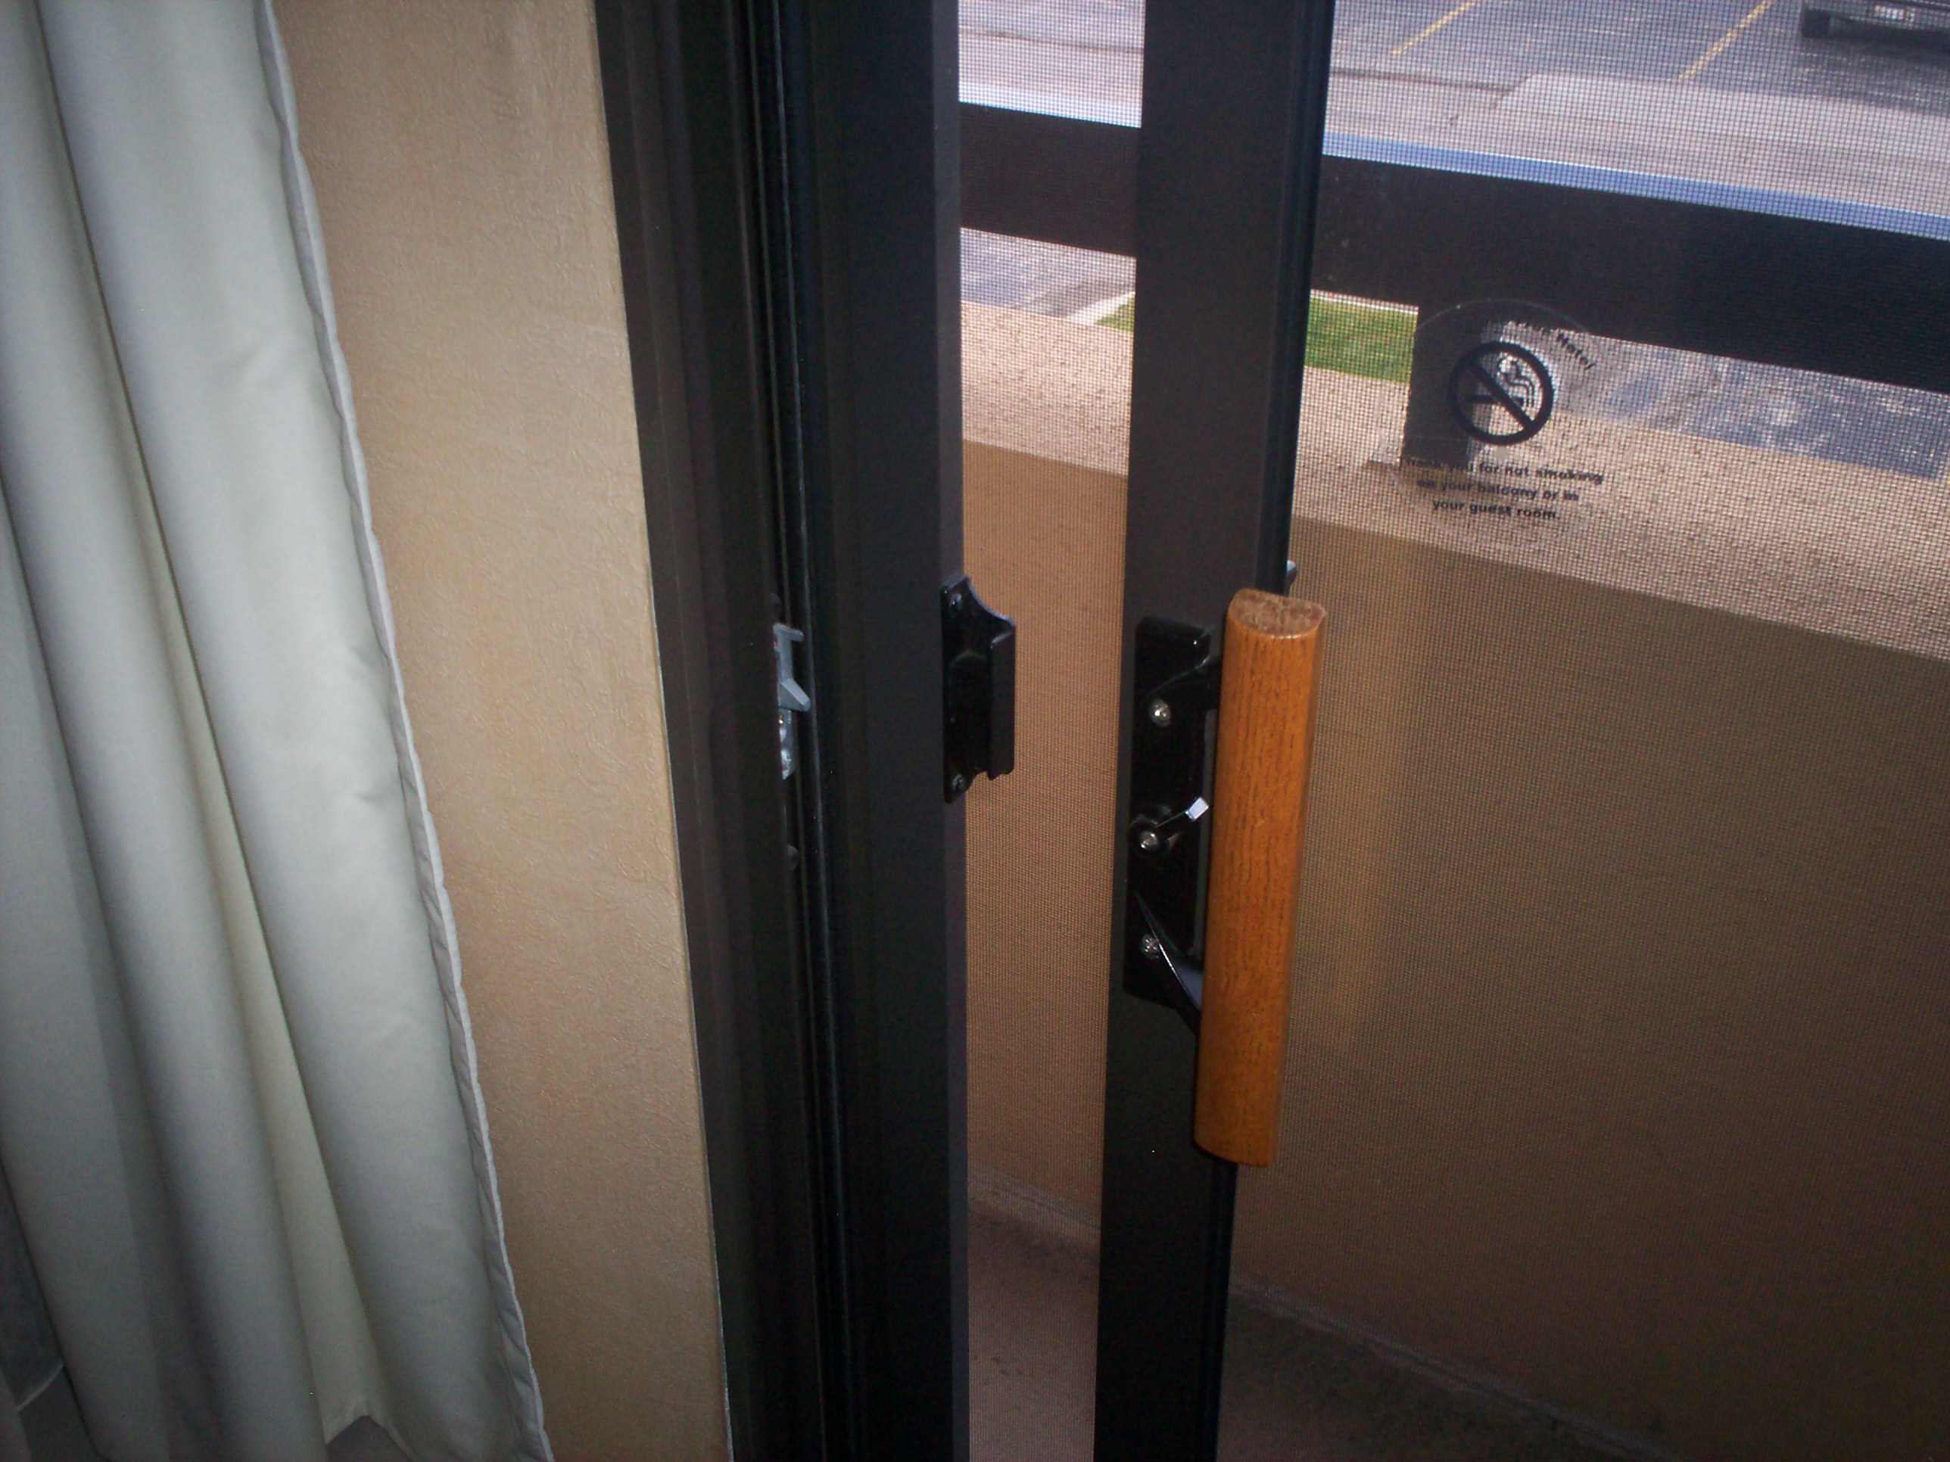
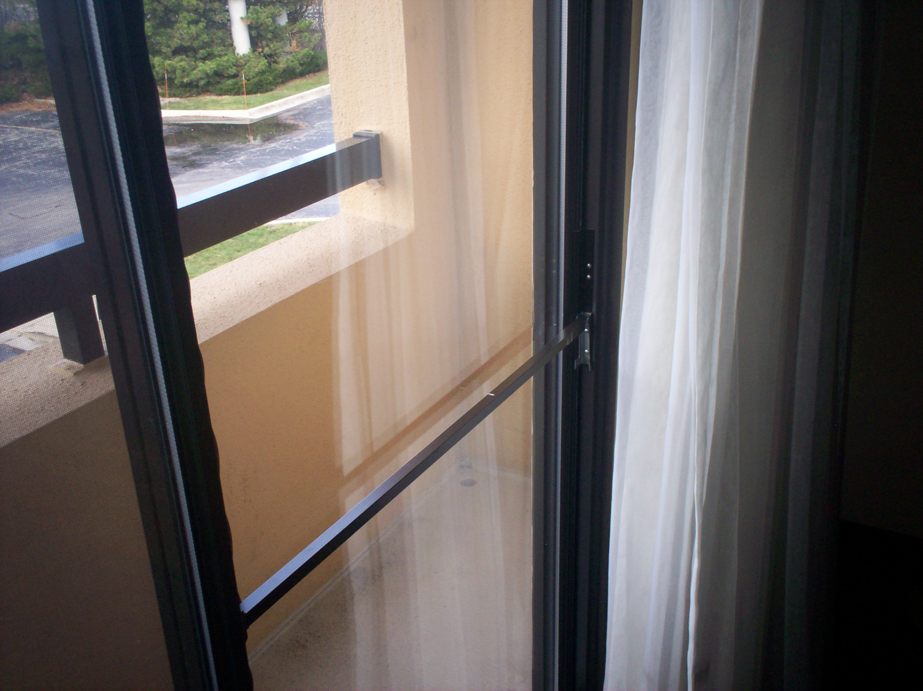
BEDROOM - Window
Items Include:
[1] Black-Out Curtains (open)
[1] Sheer Curtains (closed)
(1) Charlie bar locked and dust free

Slide 7
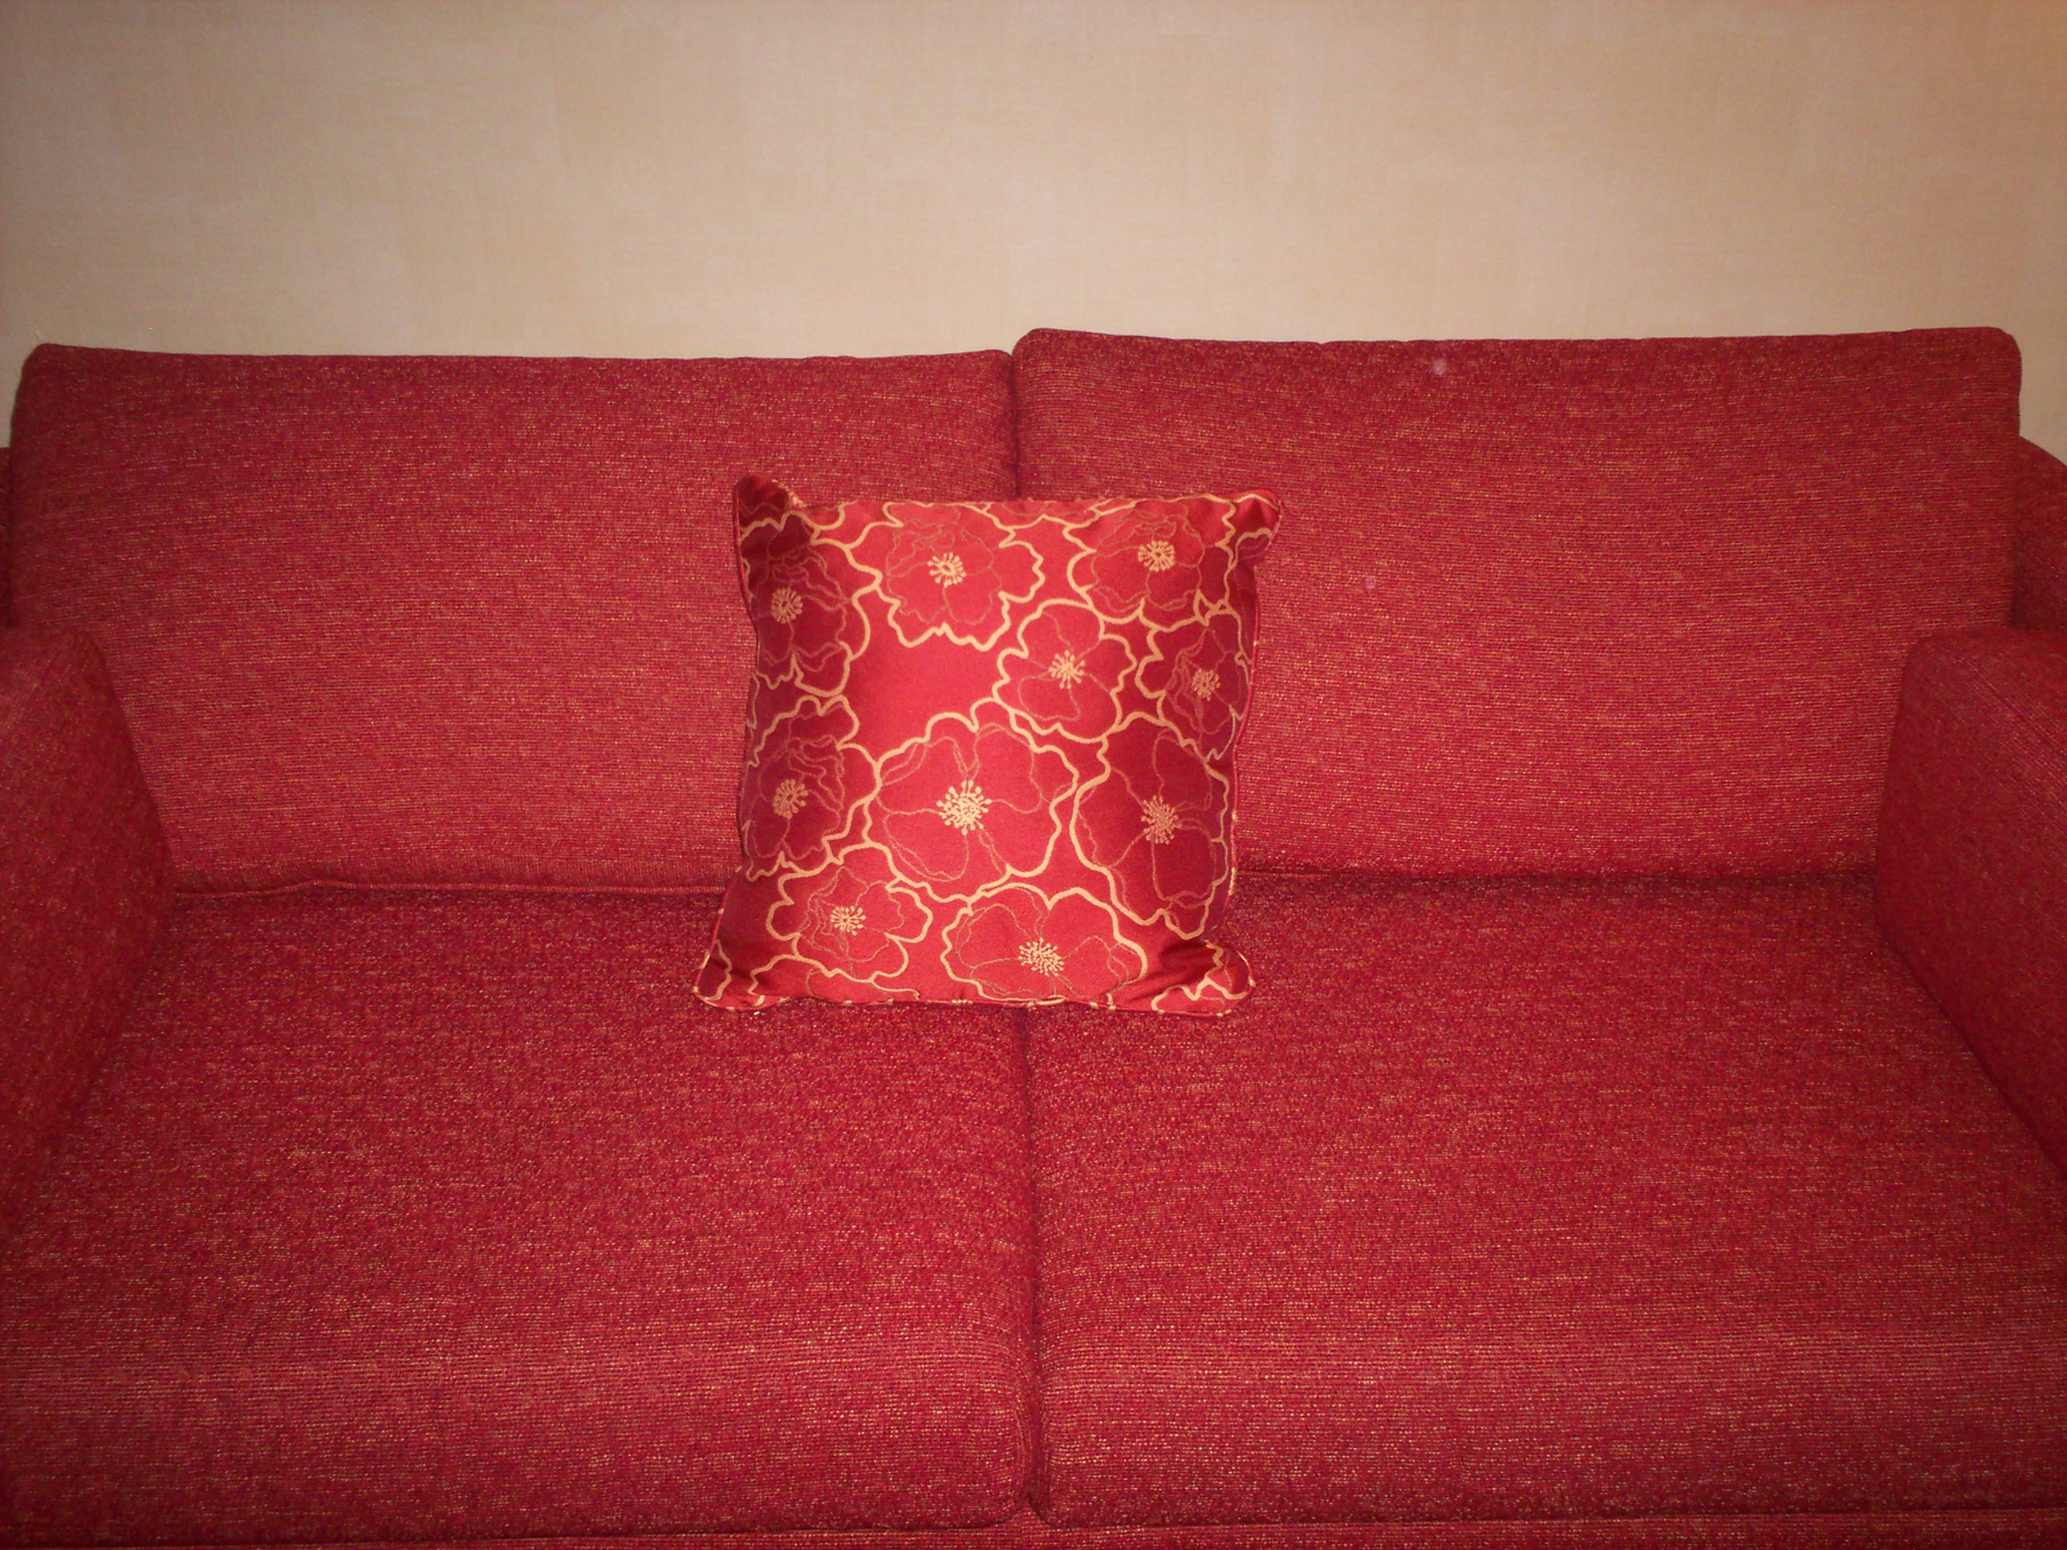
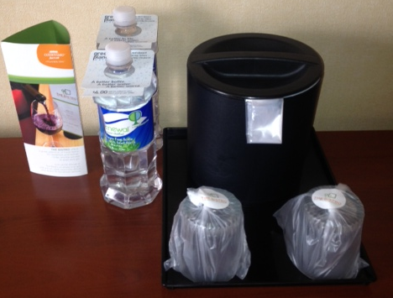
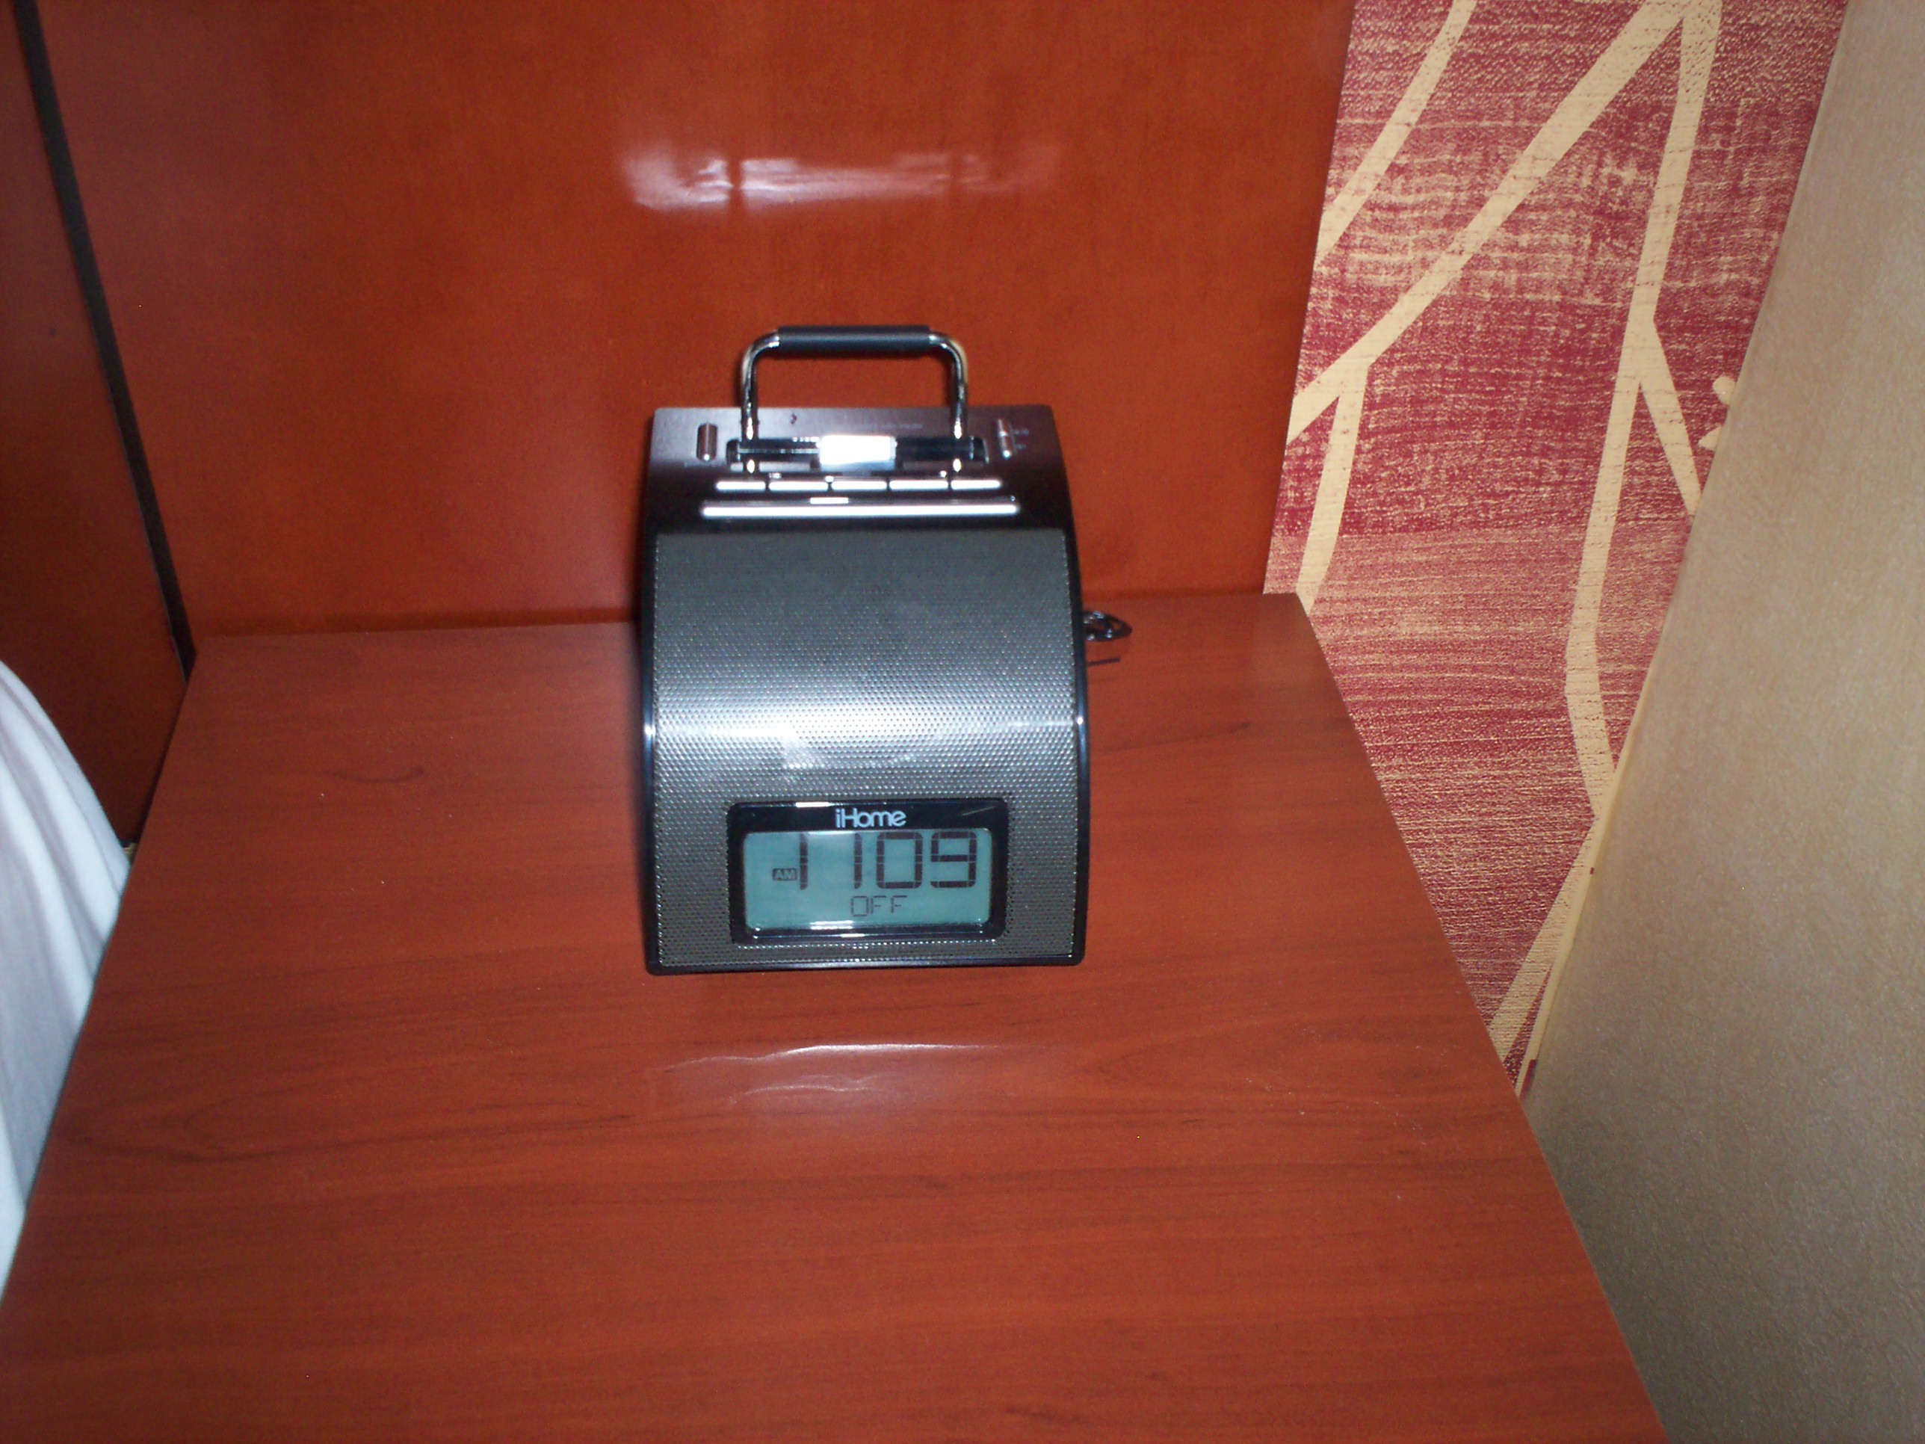
BEDROOM
Items Include:
(1) Couch or Chair and Ottoman
(1) Alarm Clock – With Alarm OFF
(1) Dresser – Drawers wiped out
(1) Ice Bucket with bag
(1) Brand Directory
(1) Marriott Reward Premier Brochure
(2) Bottle of water with collateral

Slide 8
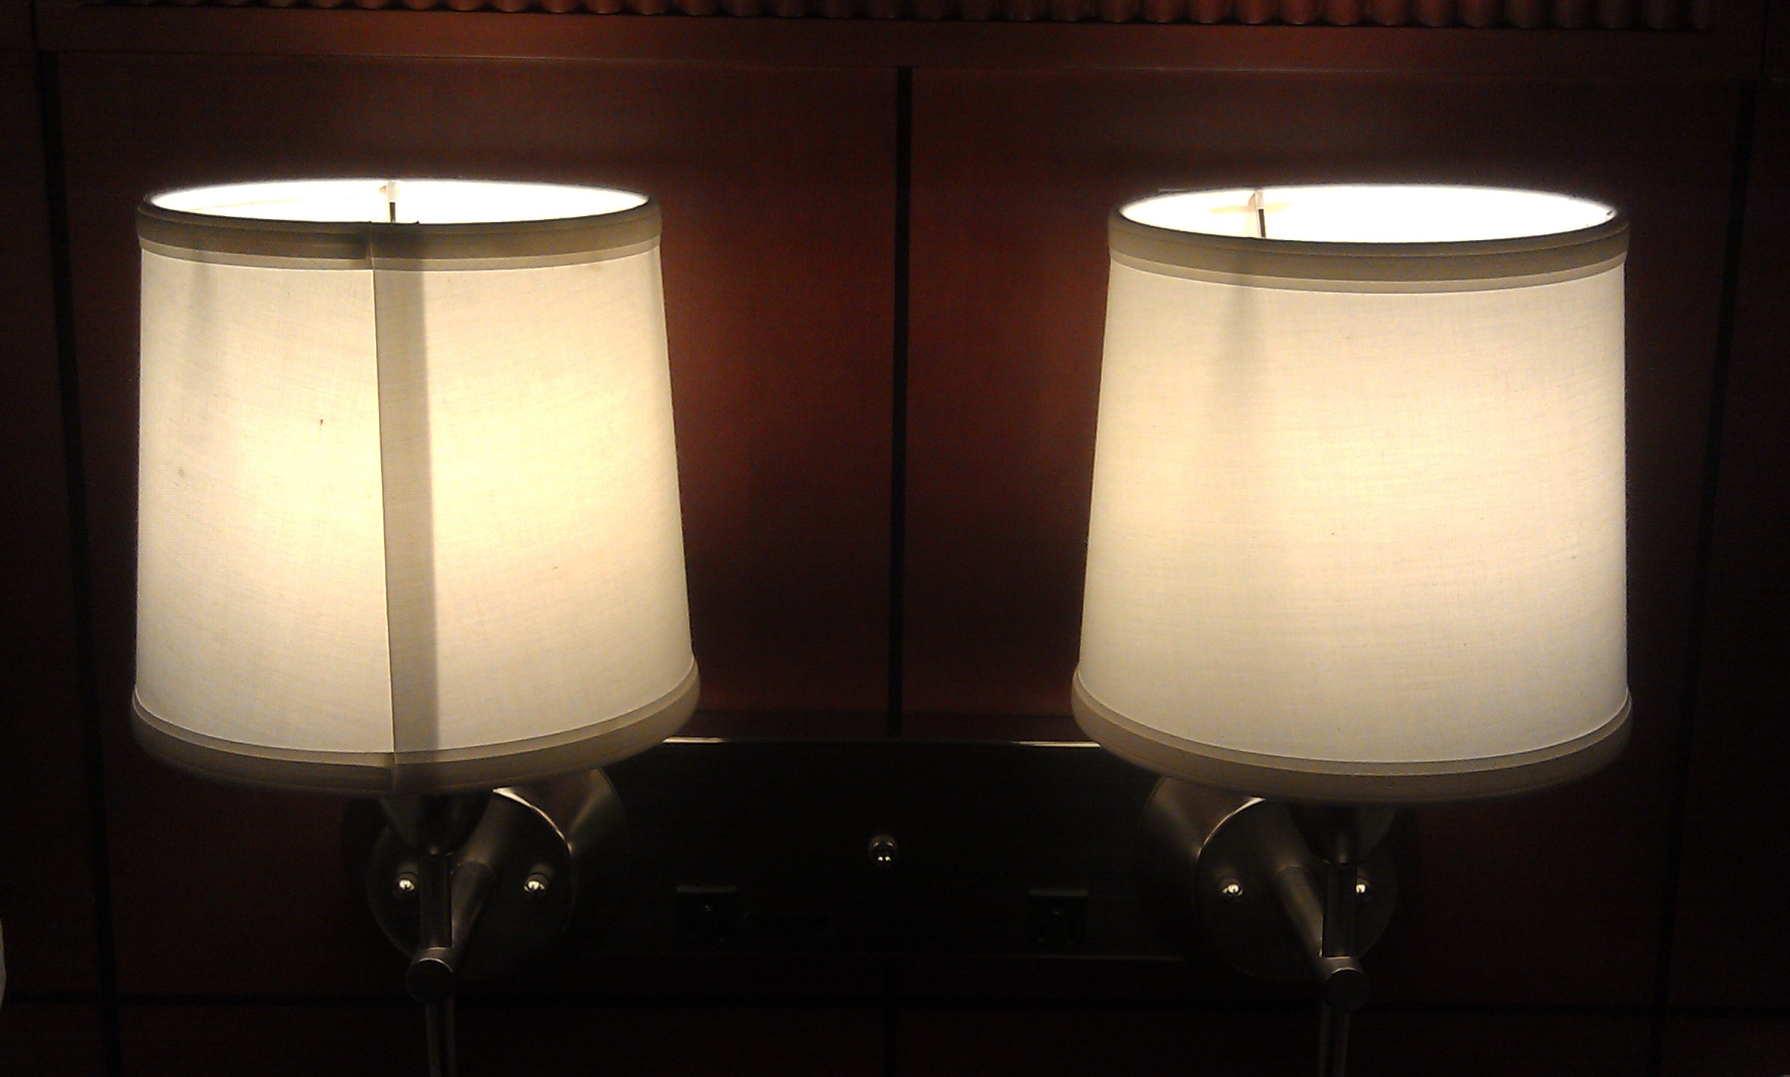
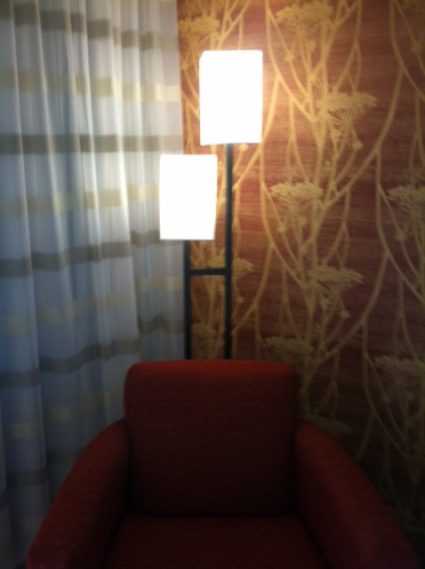
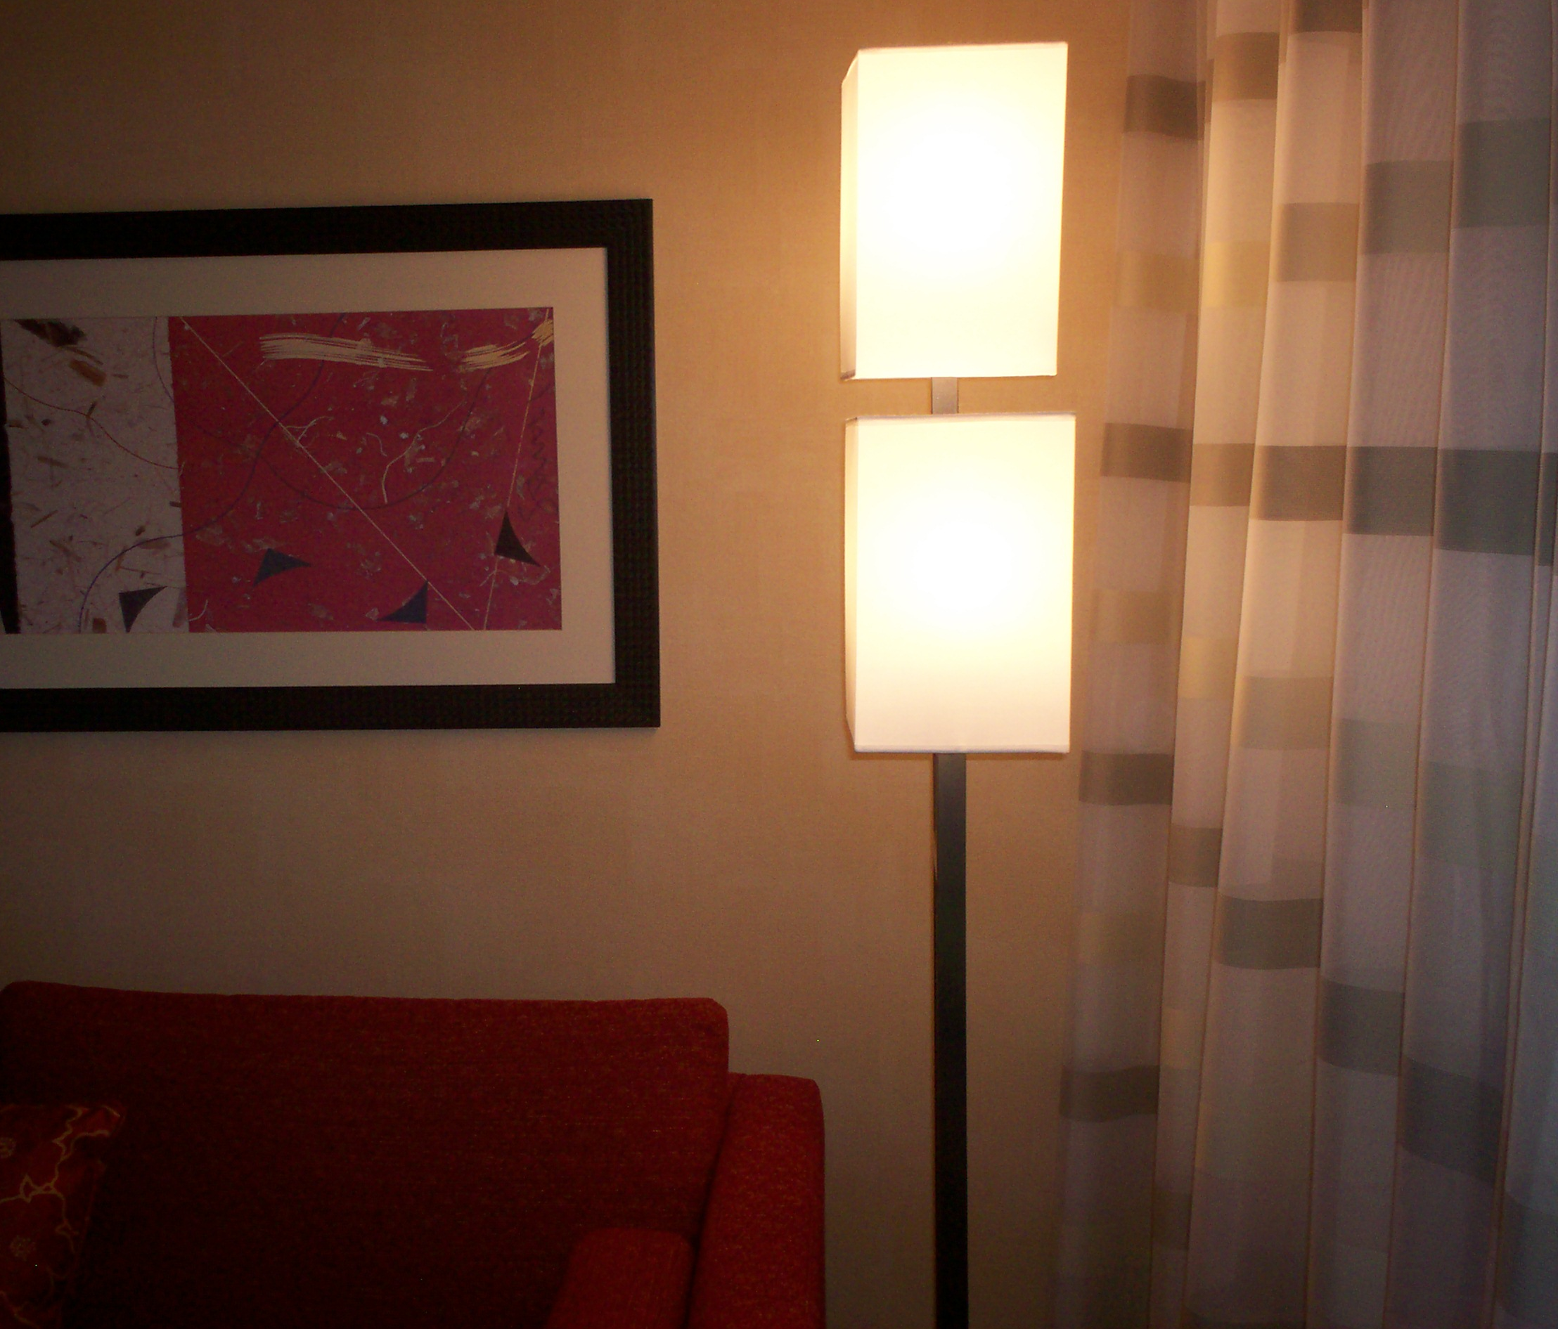
BEDROOM - Lighting
Items Include:
(1) Task Lamp
(1) Standing Floor Lamp
(2) Night Stand Lights

Slide 9
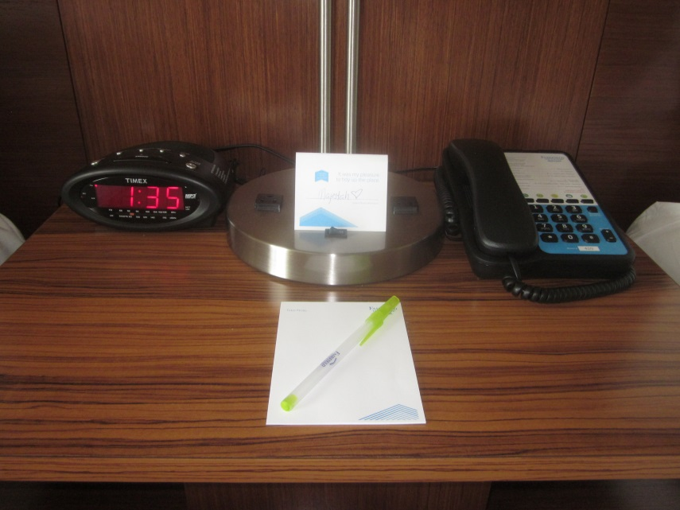
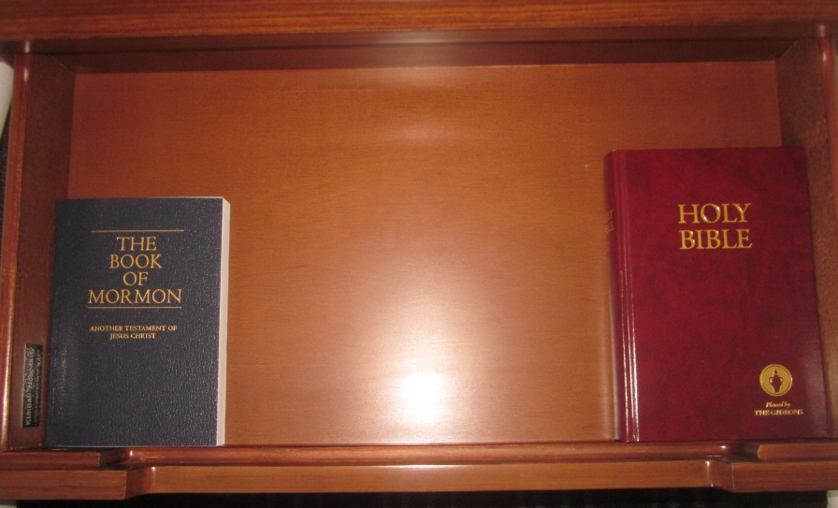
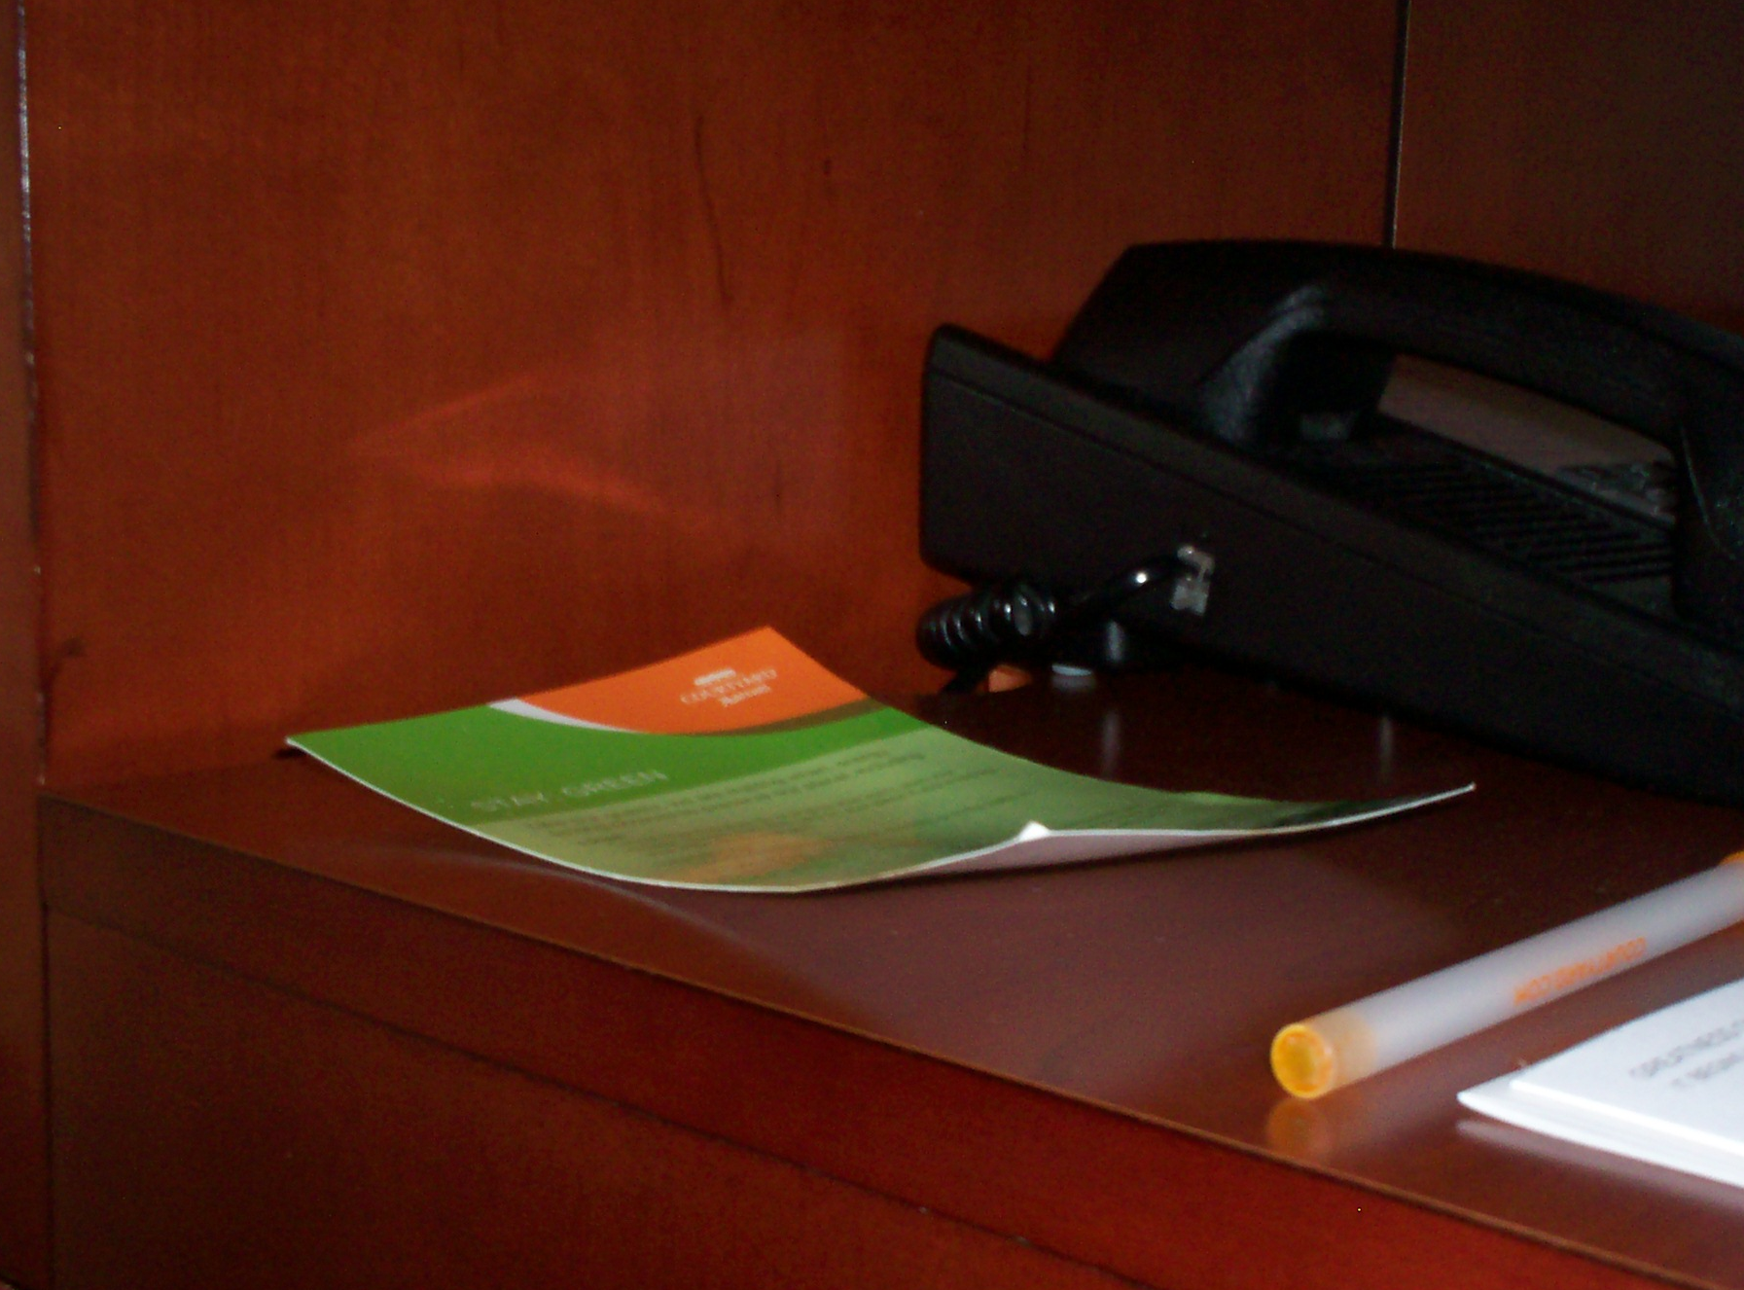
BEDROOM – NIGHTSTANDS
Items Include:
[1] Telephone with Brand Voice Faceplate –placed on nightstand
[1] Brand Voice Notepad
[1] Brand Voice Pen
(1) Name Card
[1] Alarm Clock/Radio
[1] Bible
[1] Book of Mormon

Slide 10
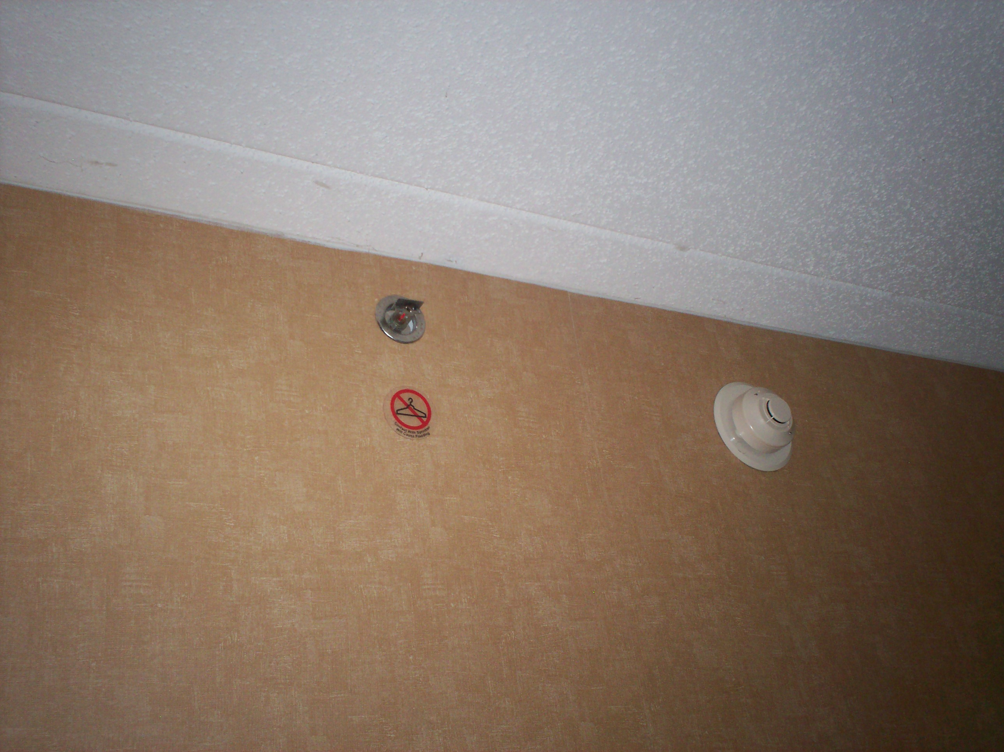
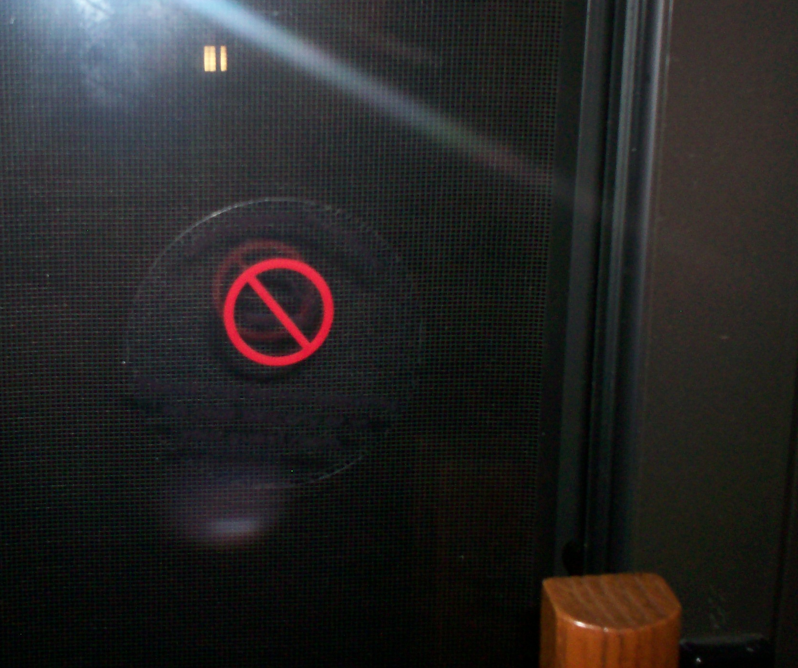
BEDROOM – NIGHTSTANDS
Items Include:
[x] No Hanger Sticker(s)
[x] No Smoking Sticker

Slide 11
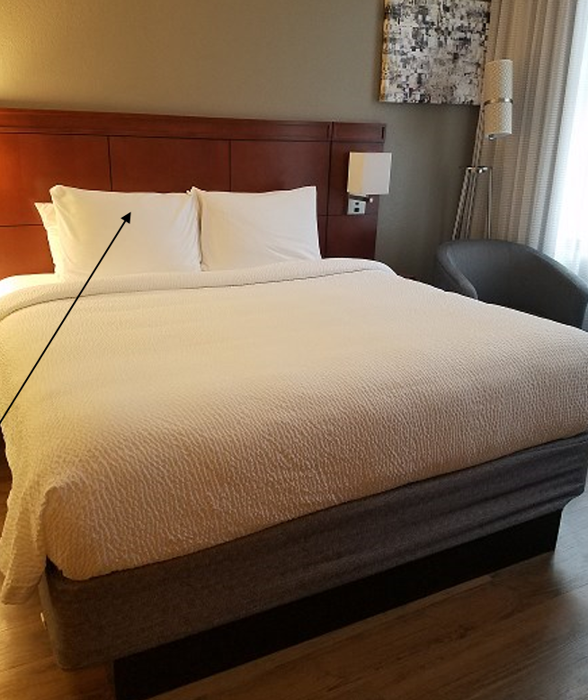
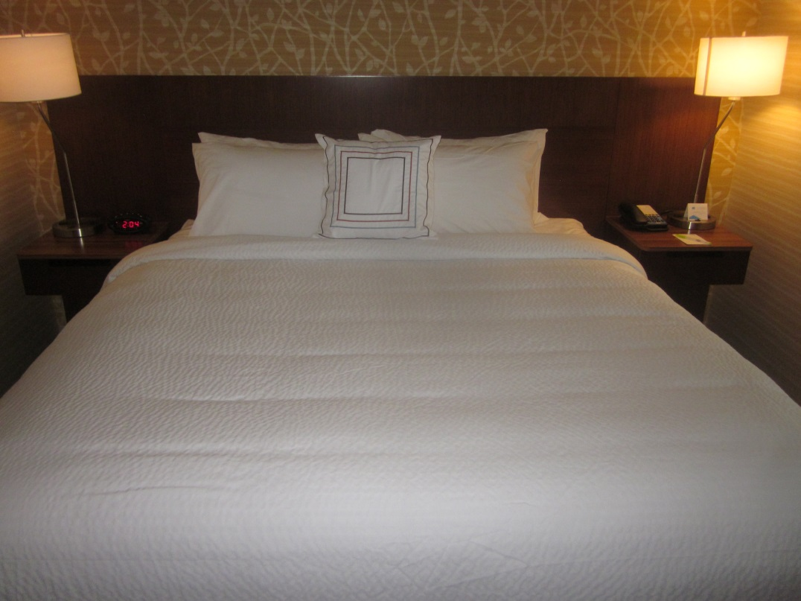
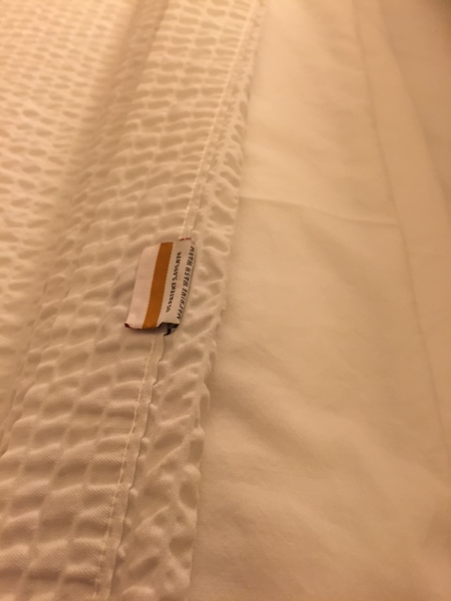
BEDROOM - KING BED
Linens Include – King Bed:
[1] Bed Skirt
[1] Mattress Pad
[1] Fitted Sheet / [1] Flat Sheet
[1] Blanket/Comforter
[1] Top Sheet/Cumulus Sheet
[2] Feather Pillows: Protective Cover & Case, ea. Placed in back
[2] Foam Pillows: Protective Cover & Case, ea. Placed in front
[1] Decorative Pillow

Slide 12
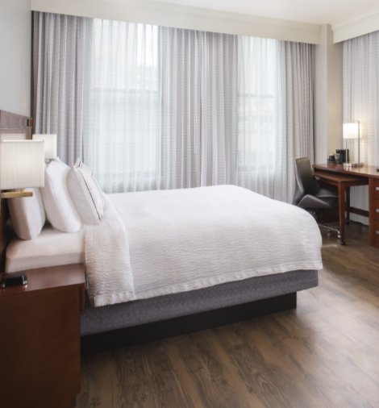
BEDROOM - KING BED

Slide 13
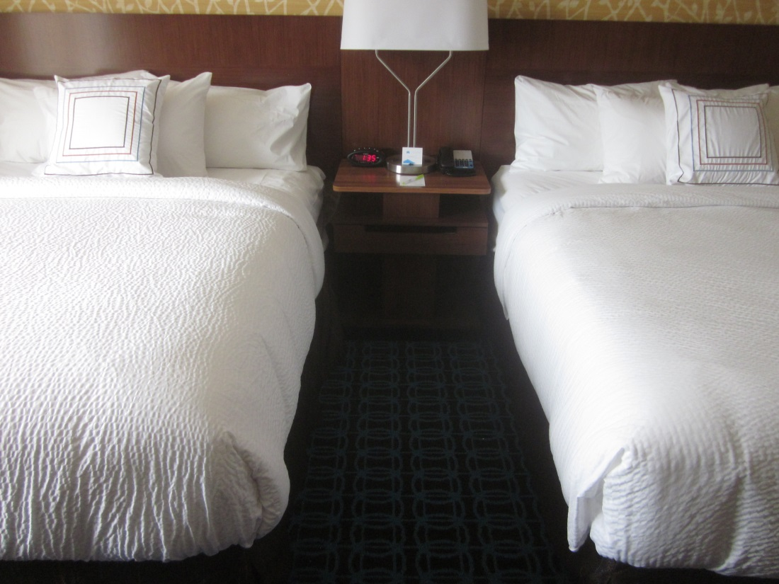
BEDROOM – Double Bed
Linens Include – Queen Bed:
[1] Bed Skirt
[1] Mattress Pad
[1] Fitted Sheet / [1] Flat Sheet
[1] Blanket/Comforter
[1] Top Sheet/Cumulus Sheet
[2] Feather Pillows: Protective Cover & Case, ea. Placed in back
[1] Foam Pillow: Protective Cover & Case, ea. Placed in front
[1] Decorative Pillow

Slide 14
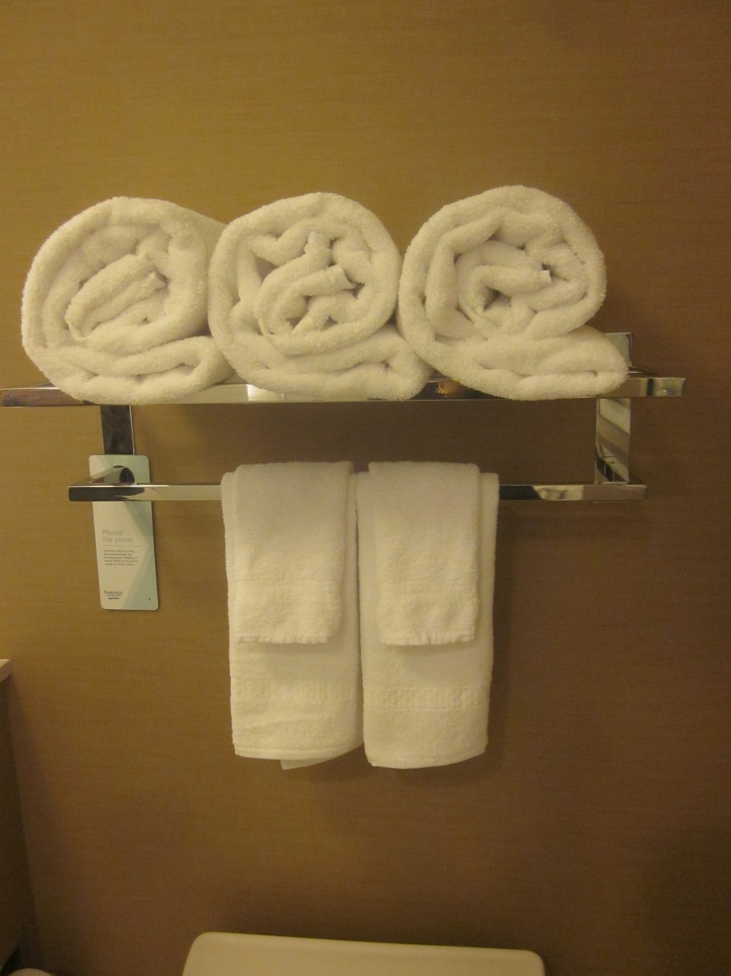
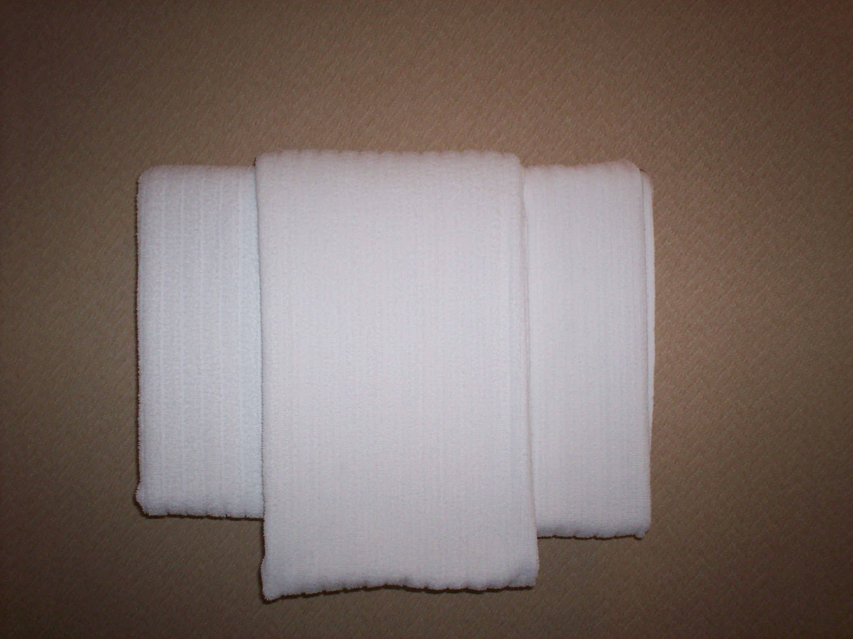
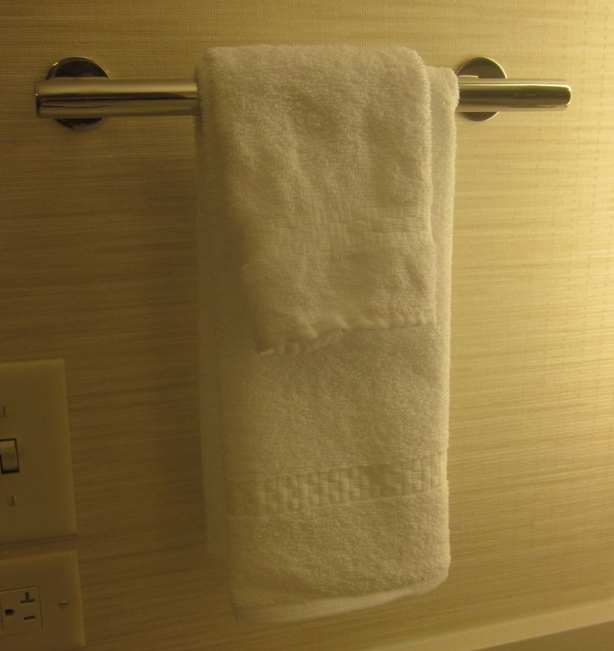
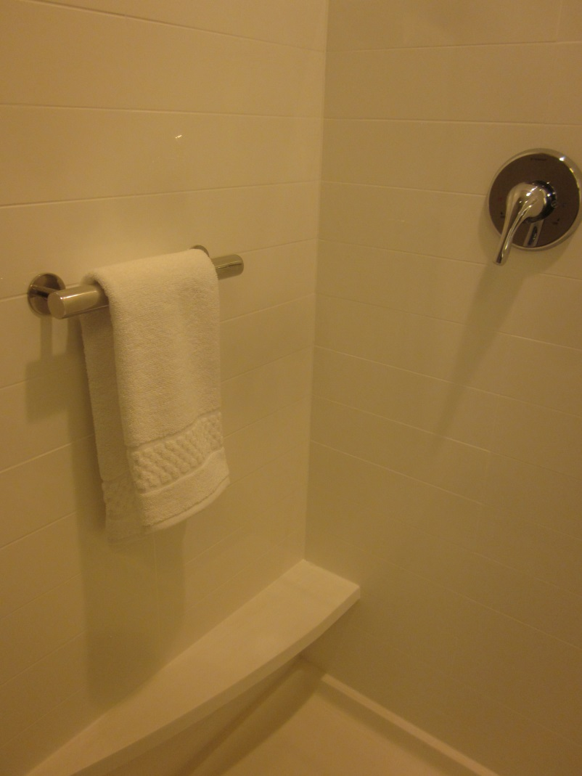
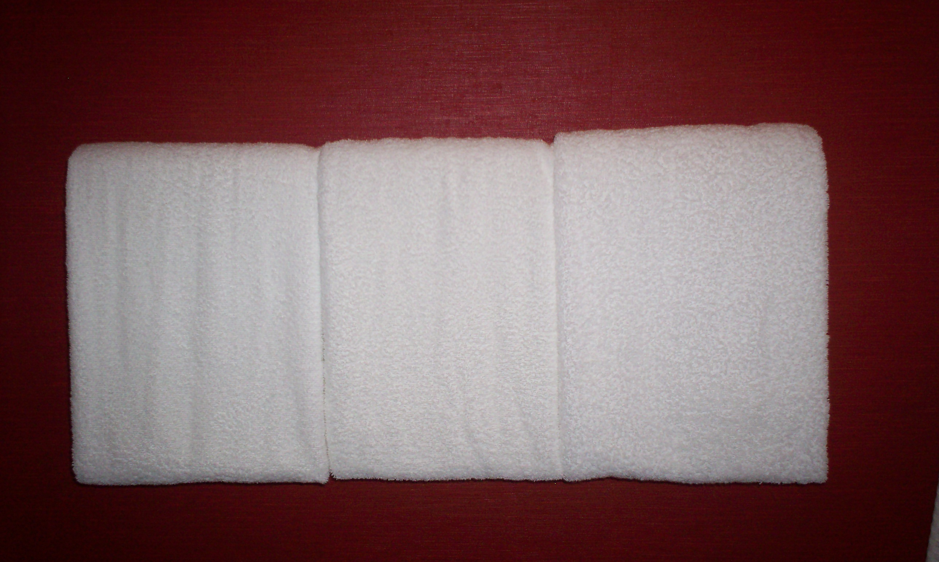
Bathroom - Terry
Items Include:
[3] Bath Towels
[3] Hand Towels
[3] Wash Cloths
[1] Bath Mat

Slide 15
Bathroom – toilet & floor
Items Include:
[3] Bath Towels
[3] Hand Towels
[3] Wash Cloths
[1] Bath Mat

Slide 16
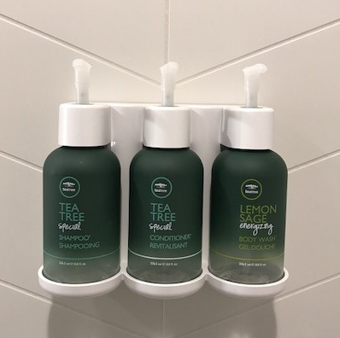
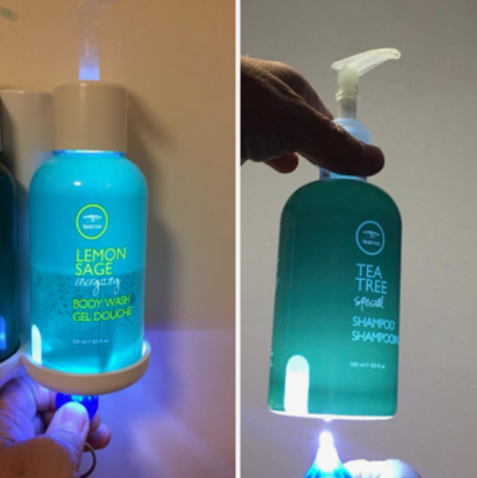
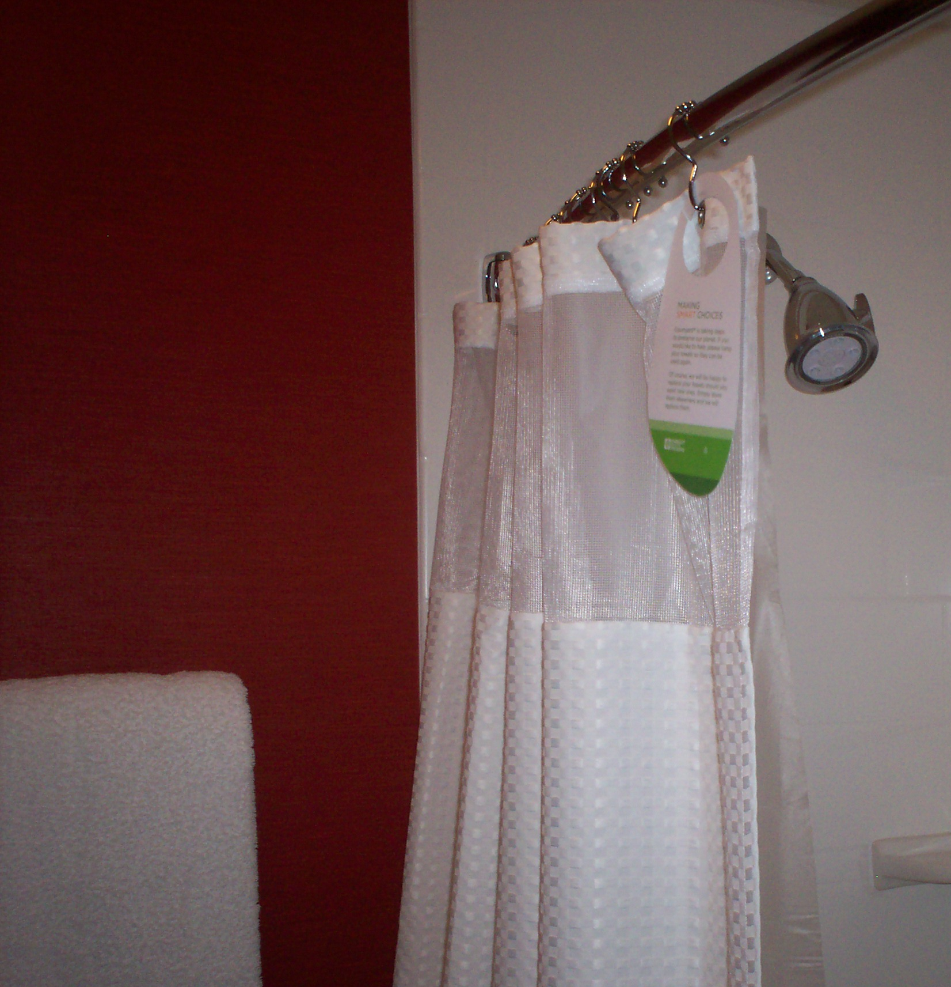
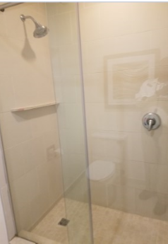
Bathroom - shower
Items Include:
[1] Curtain & Liner
[1] Shower Head
[1] Tub Drain
[1] Bath Mat
(3) Bulk Amenities – Shampoo, Conditioner, and Body Wash

Slide 17
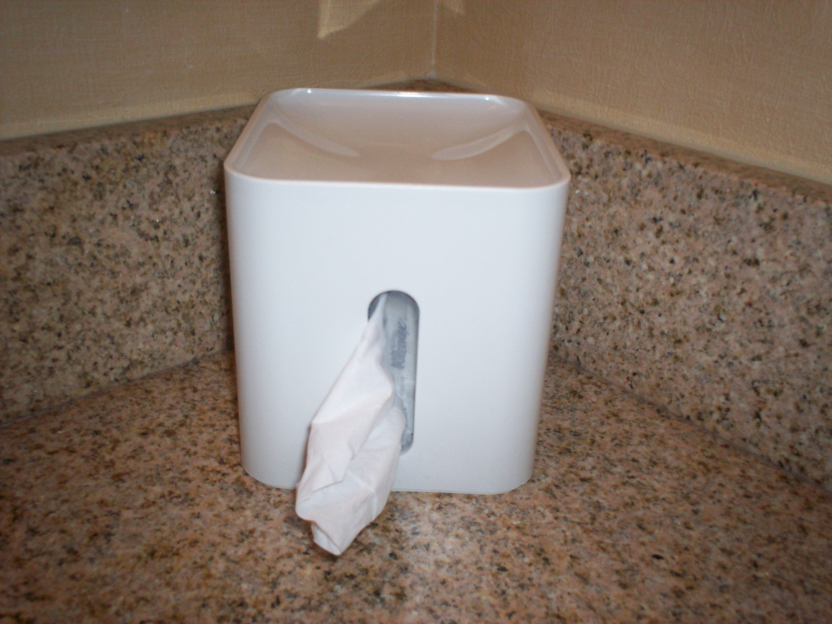
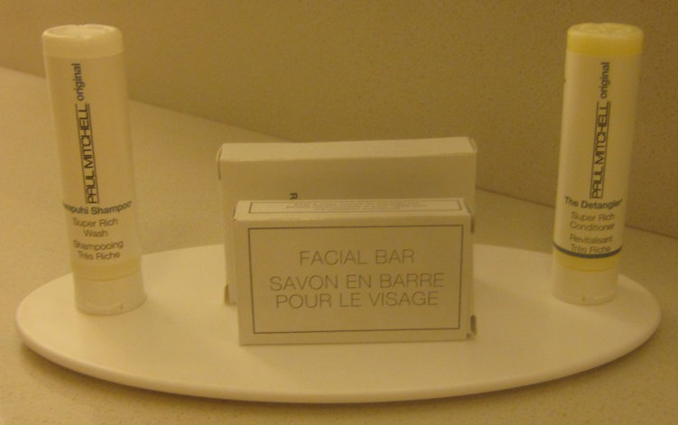
Bathroom - Counter
Items Include:
[1] Facial Tissue – simple point
[1] Presentation Tray
[1] Shampoo
[1] Conditioner
[1] Bath Soap
[1] Facial Soap
[1] Make up Mirror
(1) Faucet

Slide 18

chemicals/equipment

