Slide 1


L.E.T.S. EMPOWER
Christine Trippi
The Wise Pineapple

Slide 2


Slide 3




L.E.T.S. EMPOWER
L - Offer Limits &Guidelines: Have an empowerment policy established at your hotel so that associates understand the process, the depth of empowerment, and resources available. Ensure all leaders understand and support your hotel’s
empowerment Policy. Have a system for tracking concerns and solutions.
T – Trust: Create an environment that celebrates both successes and failures: Celebrate associates who take a risk but maybe didn’t obtain the results intended. The first time you say, " I wouldn't have done that!" It will shut associates down, and result in them saying, “Let me get my manager.”
Right from the start: number one goal is to build leaders! Begin at on-boarding! Ensure associates know they are LEADERS, and they are empowered to make it right for our and each other. Talk and practice routinely in stand-up meetings, 1:1 sessions, and hotel communication boards.
E – Educate:
Teach that it’s okay to make mistakes:
Berating an associate who tried something new will only serve to keep others from trying new things. A great way to talk about this is ask, “What else could we have done to satisfy the guest?”
There is a large correlation between Intent to Recommend and Resolution: Of those guests who experienced a problem, ITRec was 21% higher for hotels with problems that were resolved. Often you can create MORE loyalty with a guest when resolving a problem in an outstanding and memorable way.
T – Tools: Provide tools that guide associates to make great decisions and have resources available so they can ACT NOW and INDEPENDENTLY!

Slide 4
L.E.T.S.
Be Confident
LIMITS & guidelines

Slide 5
L.E.T.S. – Limits & guidelines
Create your Hotel’s Empowerment Process.
Outline the steps associates should take to resolve a guest’s concerns.
Review this upon hire, practice in Huddles, and post in all areas.
Sample =>
1
Follow the L.E.A.R.N., H.E.A.R.T., or I L.E.A.D. Model
Listen – Act – Apologize – Resolve – Notify
2
Determine the Service Recovery Quadrant
Fix It – Red Capet – Empathy - Hero
3
Follow –up with the Guest
Hear – Act – Apologize – Resolve – Thank
I – Listen – Empathize – Apologize - Deliver
6
4
5
Decide the Correct Action to Take
Use Recovery Tools and Creativity – Create value over Freebies
Own the Issue
Make it Right. Ensure the Resolution Satisfies the Guest
Ask the three Empowerment Questions
Is this the right thing to do for the customer?
Does this align with our core values
Am I willing to be held accountable for doing this?
Document in appropriate areas and communicate in shift reports.

Slide 6
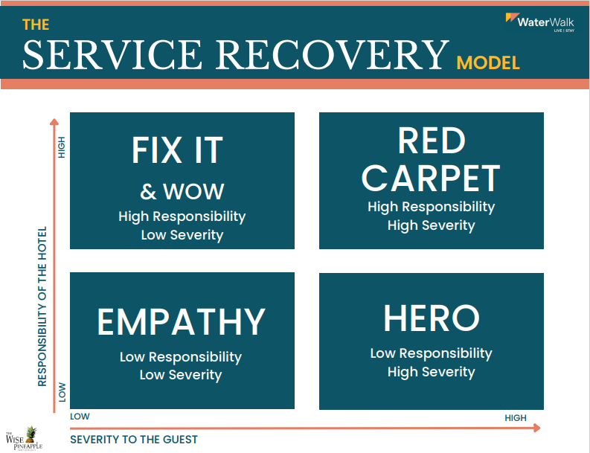
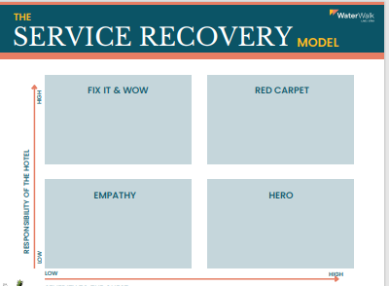
L.E.T.S. – Limits & guidelines
Use the Service Recovery Model to develop problem resolution skills. Post in areas and use with scenarios during daily stand-up meetings.
Poster =>
Worksheet=>
Notes:
!

Slide 7
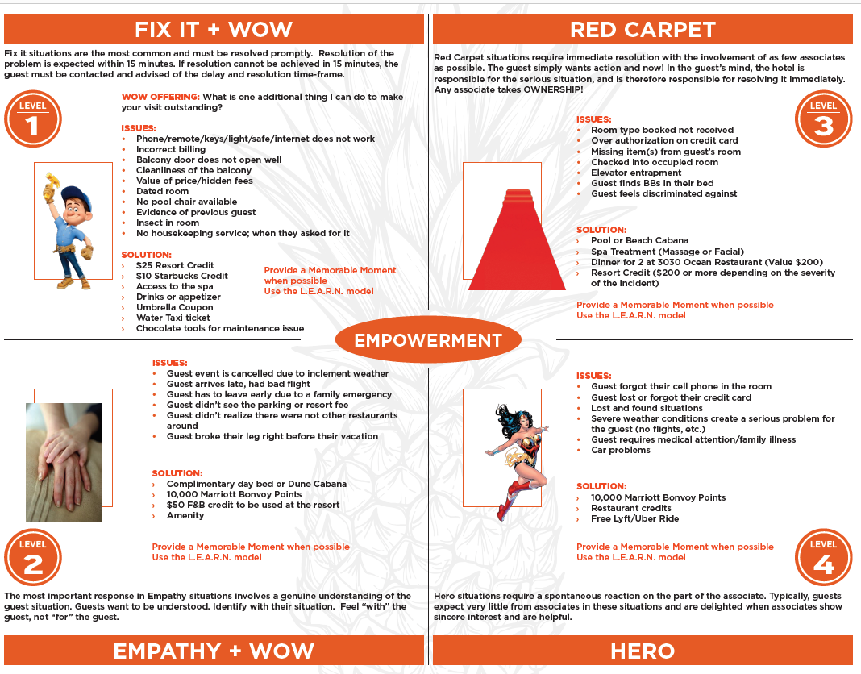
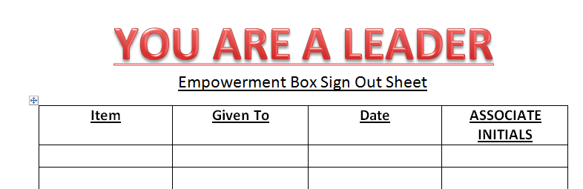
L.E.T.S. – Limits & guidelines
Help your team members have the confidence to ACT by providing some Limits and Guidelines.
This way, they will know these ideas, and others like them are already stamped with your approval. Here is a great example of Empowerment guidelines.
Empowerment log =>

Slide 8
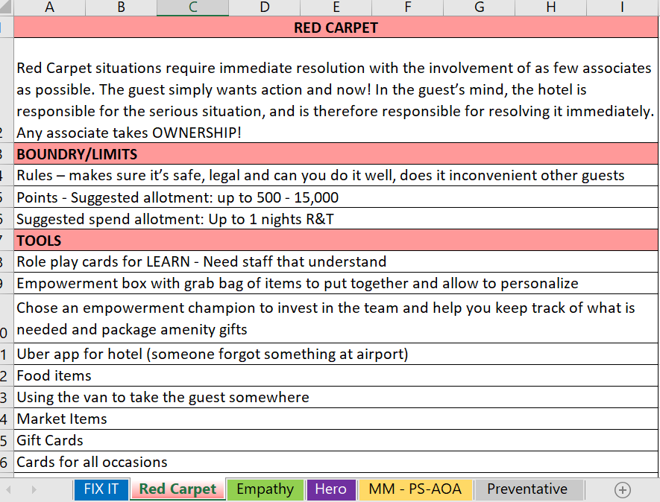
L.E.T.S. – Limits & guidelines
Help your team members have the confidence to ACT by providing some Limits and Guidelines. This way, they will know these ideas, and others like them are already stamped with your approval. Here is a great example of Empowerment guidelines.
L.E.T.S Empower
Workbook =>

Slide 9
L.E.T.S. – Limits & guidelines
Use these posters to help promote H.E.A.R.T.
L.E.T.S Empower
Posters =>
H.E.A.R.T YES Wise Pineapple
WaterWalk Posters = >
Double Click the poster

Slide 10

L.E.T.S. – EDUCATE
Talk about empowerment daily and reinforce that you trust and depend on the team’s leadership.
Create a Huddle Pack to be ready to role play and provide scenarios for associates to practice their problem solving, delighting, and empowerment skills.
Samples =>
To Purchase a Pineapple Pack email Christine@thewisepineapple.com

Slide 11
L.E.T.S.
Be Empowered
Tools & Resources

Slide 12
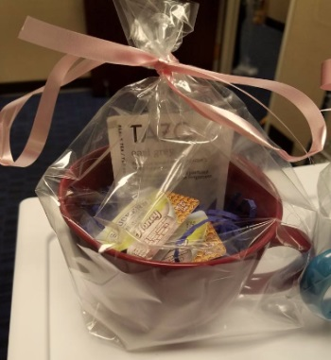
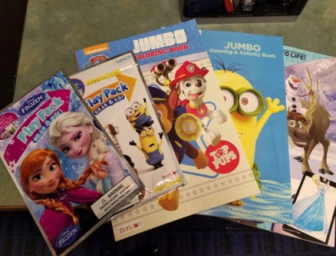
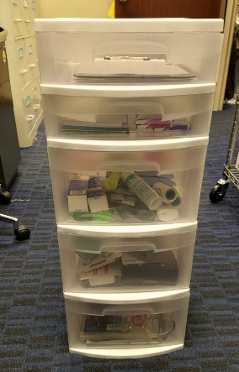
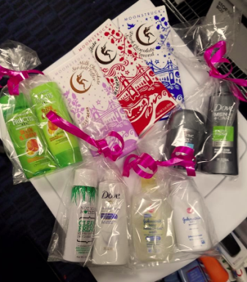
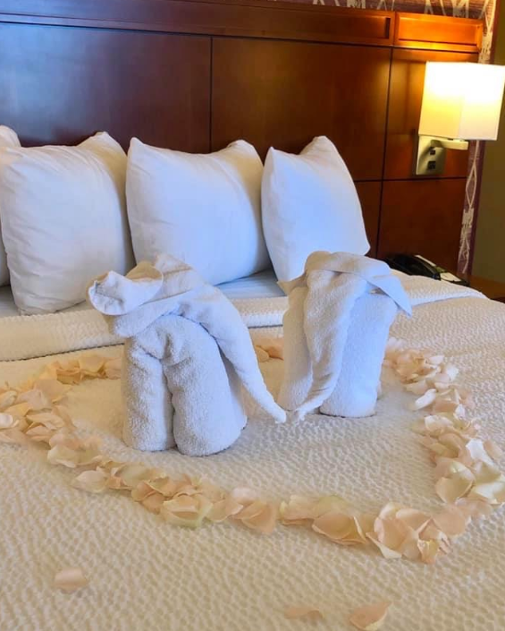
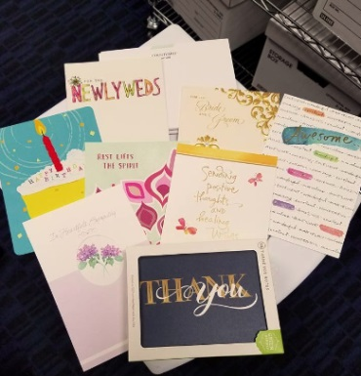
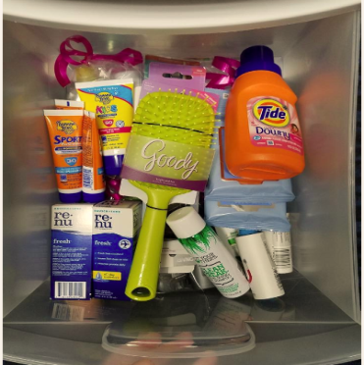
L.E.T.S. – Tools & Resources
Create an Empowerment Box in each department or a specific area for all associates to use when they quickly need a delighter or a recovery item.
Examples Include: Candy, cards, Be Our Guest certificates, amenities, gift cards, stickers, tattoos, lolly pops, etc.
This way, associates won’t have to think about what to do; they’ll be ready to ACT NOW and execute!
SAMPLES =>

Slide 13
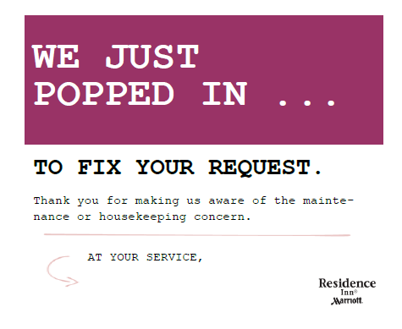
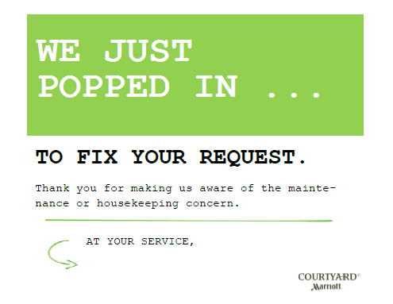
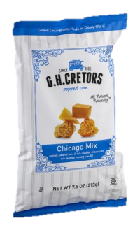

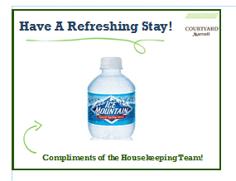
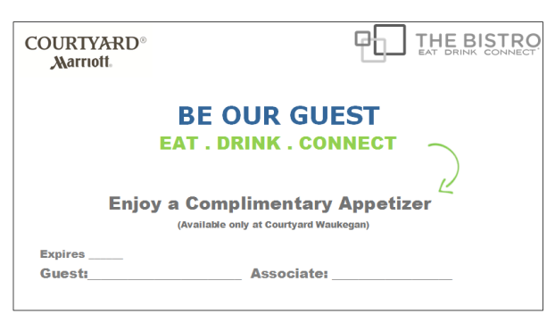

L.E.T.S. – Tools & Resources
SAMPLES

Slide 14
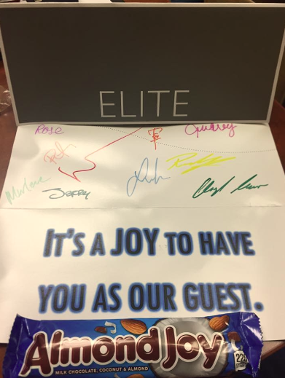
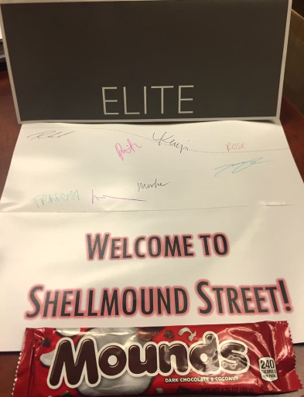
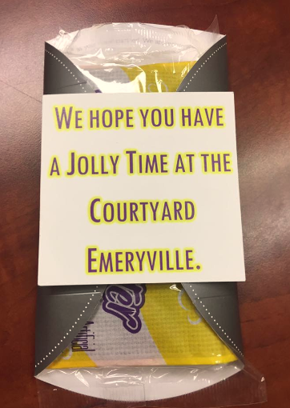
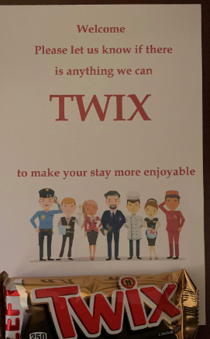
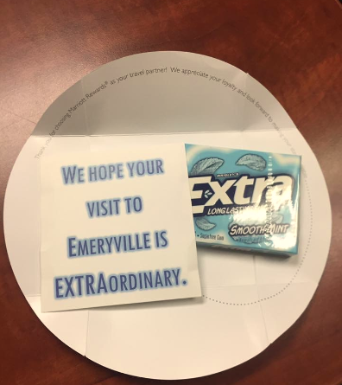
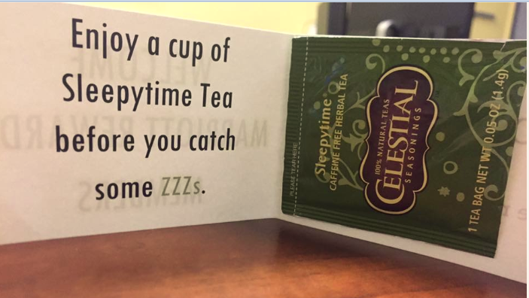
L.E.T.S. – Tools & Resources
SAMPLES

Slide 15
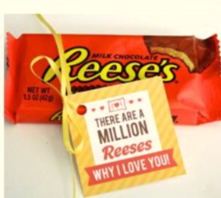
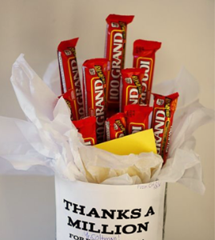


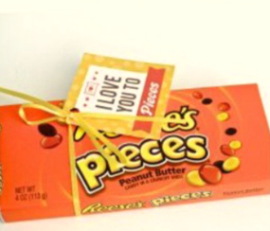
L.E.T.S. – Tools & Resources
SAMPLES
Change “I Love You” to “Why we appreciate you” “Our Appreciation is”

Slide 16
L.E.T.S.
Lead from the Heart
Trust

Slide 17

L.E.T.S. – TRUST
You Are empowered!
Ultimately, to build leaders, you need to give them autonomy and trust. Here is my three-question tool to guide team members to ACT on empowerment.
If they can say YES to all three questions, they will know 100% we trust them to make the right decision!
SIGN FOR BACK
OFFICE => See set of posters
Is what you’re about to do the right thing for the guest?
Does it align with the core values of our company?
Are you willing to be held accountable?

Slide 18

L.E.T.S. – trust
A culture of TRUST doesn’t happen over night. It’s built up of the little things we do and say every day!
We typically tell associates what they CAN’T do. With this great approach by Simon Sinek, you can empower associates to be problem solvers and LEADERS!! Great idea to print this and post in your back office areas.
You are allowed poster =>

