Slide 1



Say YES to Kindness
Say YES to Kindness
Write a nice note to someone
Learn to say “Welcome” in a different language:
Bienvenidos (Spanish)
Bienvenue (French)
Yokoso (Japanese)
Huanying guanglin (Chinese Mandarin
Benvenuto (Italian)
Be Sweet – Lead from the Heart
Be Sweet – Lead from the Heart
Say YES to Kindness
Say YES to Kindness
Share a favorite recipe, maybe one that is a family tradition and the story of why it’s so special to you.
Give someone a small gift for no reason.
Be Sweet – Lead from the Heart
Be Sweet – Lead from the Heart

Slide 2
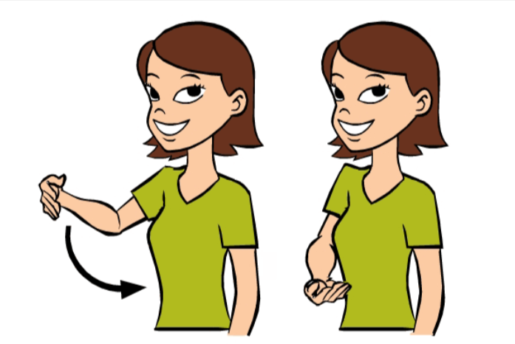
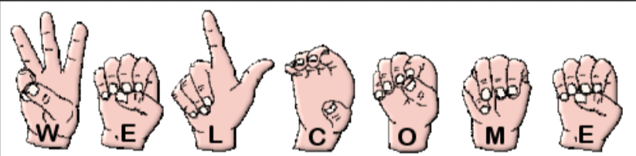
Say YES to Kindness
Say YES to Kindness
Write a list of things you love about a person and give it to them.
Learn to say, “Welcome” in Sign Language.
Be Sweet – Lead from the Heart
Be Sweet – Lead from the Heart
Say YES to Kindness
Say YES to Kindness
Tell your family how much you appreciate them. Give actual examples of why.
Teach someone something new today or share one of your best practices with someone.
Be Sweet – Lead from the Heart
Be Sweet – Lead from the Heart

Slide 3
Say YES to Kindness
Say YES to Kindness
Say “Hello” to 5 Strangers today.
Play a song that pumps you up or makes you feel great!
Be Sweet – Lead from the Heart
Be Sweet – Lead from the Heart
Say YES to Kindness
Say YES to Kindness
Share a favorite quote with someone.
Find a song that brings back a memory with someone and share it with that person. Remind them of the memory and why it’s so special to you!
Be Sweet – Lead from the Heart
Be Sweet – Lead from the Heart

Slide 4

Say YES to Kindness
Say YES to Kindness
Learn to say “Hello” in a different language.
Hola (Spanish)
Bonjour (French)
Guten Tag (German)
Konnichi wa (Japanese)
Ciao (Italian)
Learn to say “Hello” in Sign Language.
Be Sweet – Lead from the Heart
Be Sweet – Lead from the Heart
Say YES to Kindness
Say YES to Kindness
Call a friend or relative you wish you spoke to more often to check in!
Write a thank you note to someone.
Be Sweet – Lead from the Heart
Be Sweet – Lead from the Heart

Slide 5
Say YES to Kindness
Say YES to Kindness
Hold the door open for 3 people today.
Give a genuine compliment to 3 people today.
Be Sweet – Lead from the Heart
Be Sweet – Lead from the Heart
Say YES to Kindness
Say YES to Kindness
Let someone go ahead of you in line today.
Send someone a text with a GIF of something that will make them laugh.
Be Sweet – Lead from the Heart
Be Sweet – Lead from the Heart

Slide 6
Say YES to Kindness
Say YES to Kindness
Volunteer for something today. Take out someone’s trash, bring someone coffee, make dinner, etc.
Donate clothes or food.
Be Sweet – Lead from the Heart
Be Sweet – Lead from the Heart
Say YES to Kindness
Say YES to Kindness
As a customer, give the clerk service provider a lotto ticket and thank them!
Write a book or service review
Be Sweet – Lead from the Heart
Be Sweet – Lead from the Heart

